Slide 1

Git Concepts I Wish I Knew Years Ago
Sanjula Ganepola
Software Developer – IBM i App Dev & AI Toolchain
Sanjula.Ganepola@ibm.com
2025 February

Slide 2
Agenda
Git Basics
Using Git in a Team
Branching and Merge Conflicts
Merge Commits vs. Rebase Merging vs. Squash Merging
Tips and Tricks
Git in VS Code

Slide 3
How well do you know Git?
🤩 Never used it I have not used Git before, but I am interested!
🧐 Beginner I just started learning the basics.
👨‍🎓 Intermediate I understand the basics, but I am not familiar with advanced concepts.
🕵️ Expert I have a deep understanding of Git.

Slide 4
Git Basics

Slide 5
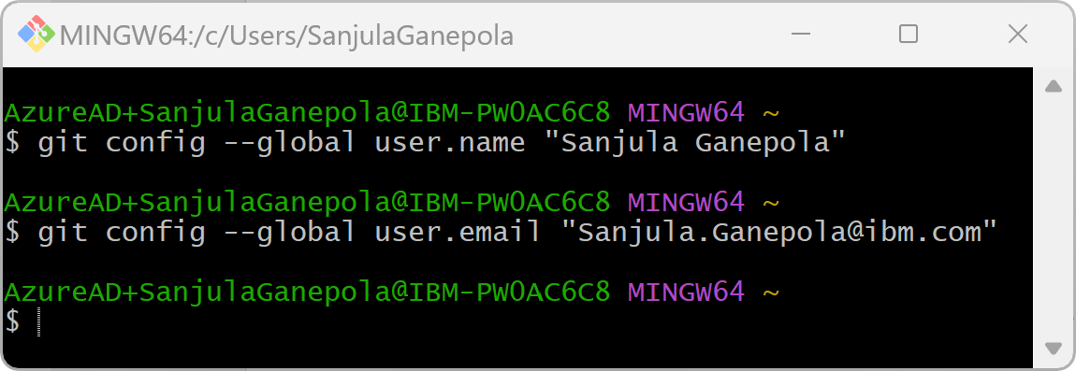
Let’s get setup
Let’s do this once …
Install Git on your PC:
https://git-scm.com/downloads
Setup your name and email in your Git config:

Slide 6
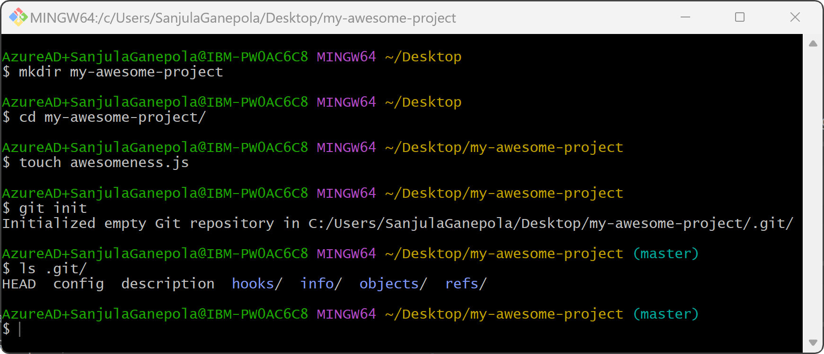
Setup a new project with Git

Slide 7




Where does your code live?
WORKING DIRECTORY
STAGING AREA
LOCAL REPO
REMOTE REPO
Where we actively edit local files (our playground)
Temporary location for changes before committing
Where we store committed changes locally
A sever (such as GitHub) for sharing and backing up code

Slide 8
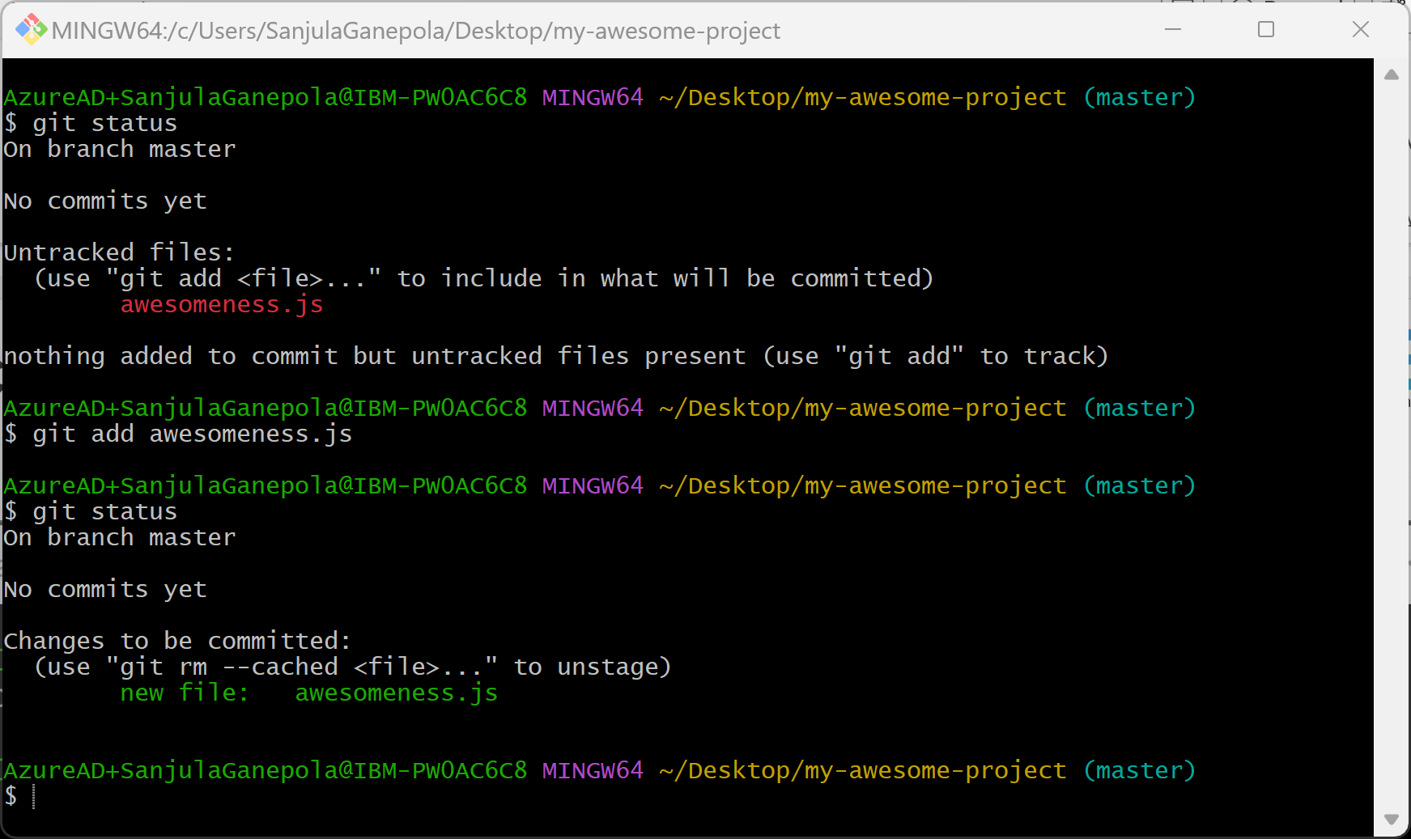
Moving code to the staging area
WORKING DIRECTORY
STAGING AREA
LOCAL REPO
REMOTE REPO

Slide 9
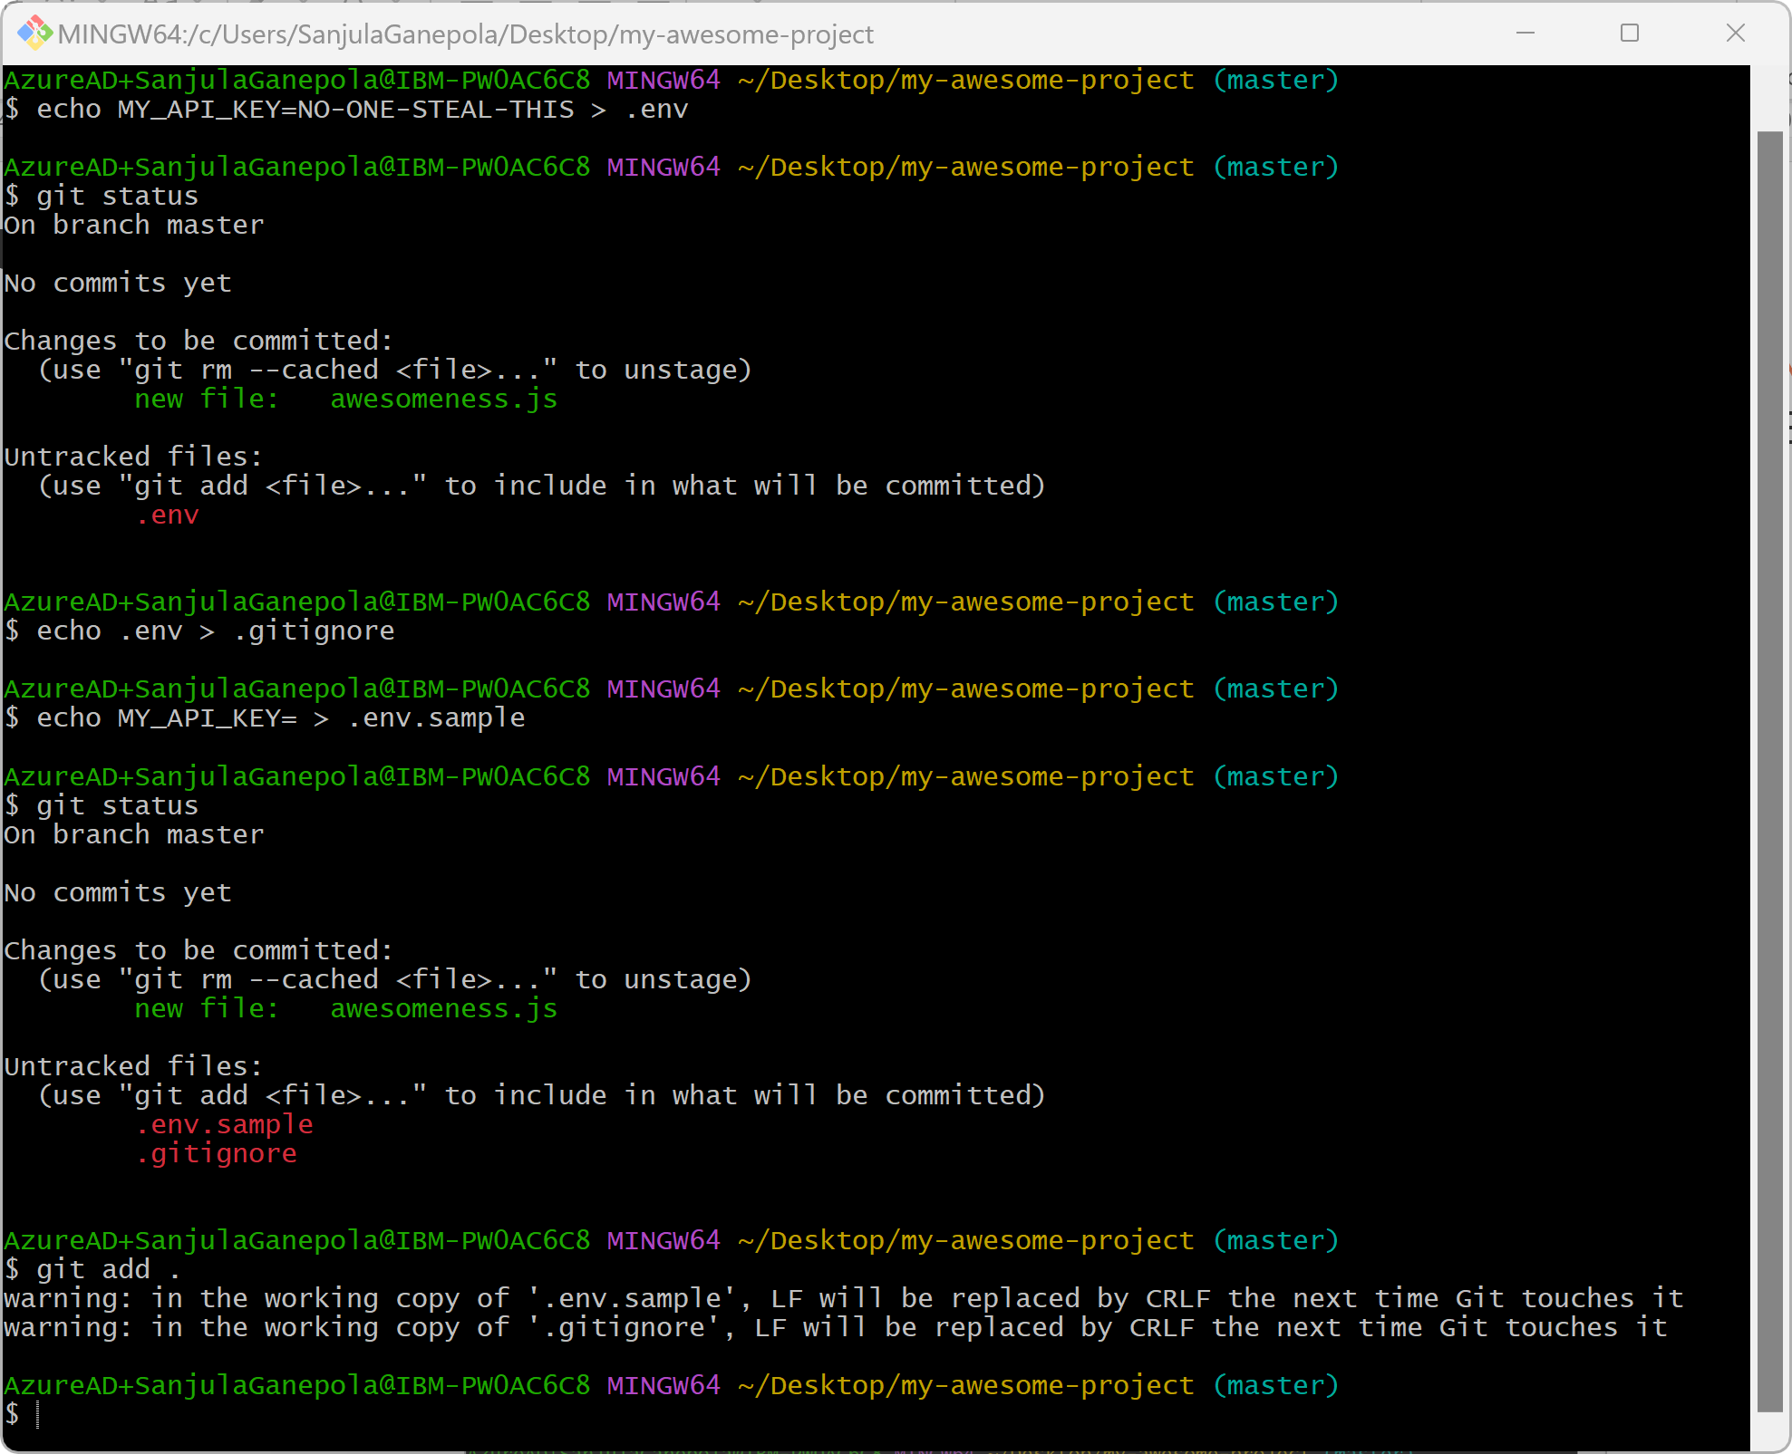
Excluding files from being tracked
WORKING DIRECTORY
STAGING AREA
LOCAL REPO
REMOTE REPO

Slide 10
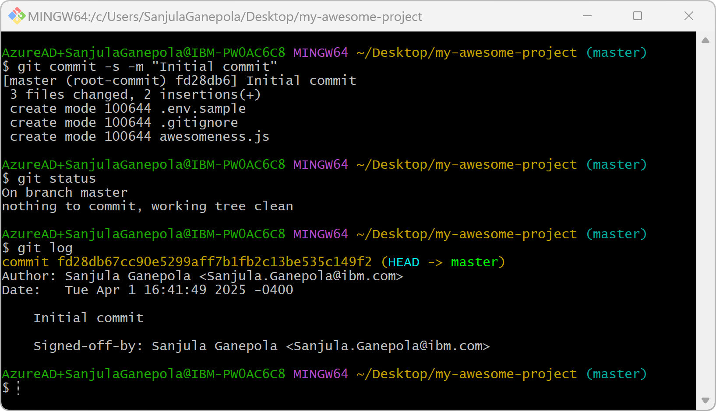
Committing files to the local repository
WORKING DIRECTORY
STAGING AREA
LOCAL REPO
REMOTE REPO

Slide 11
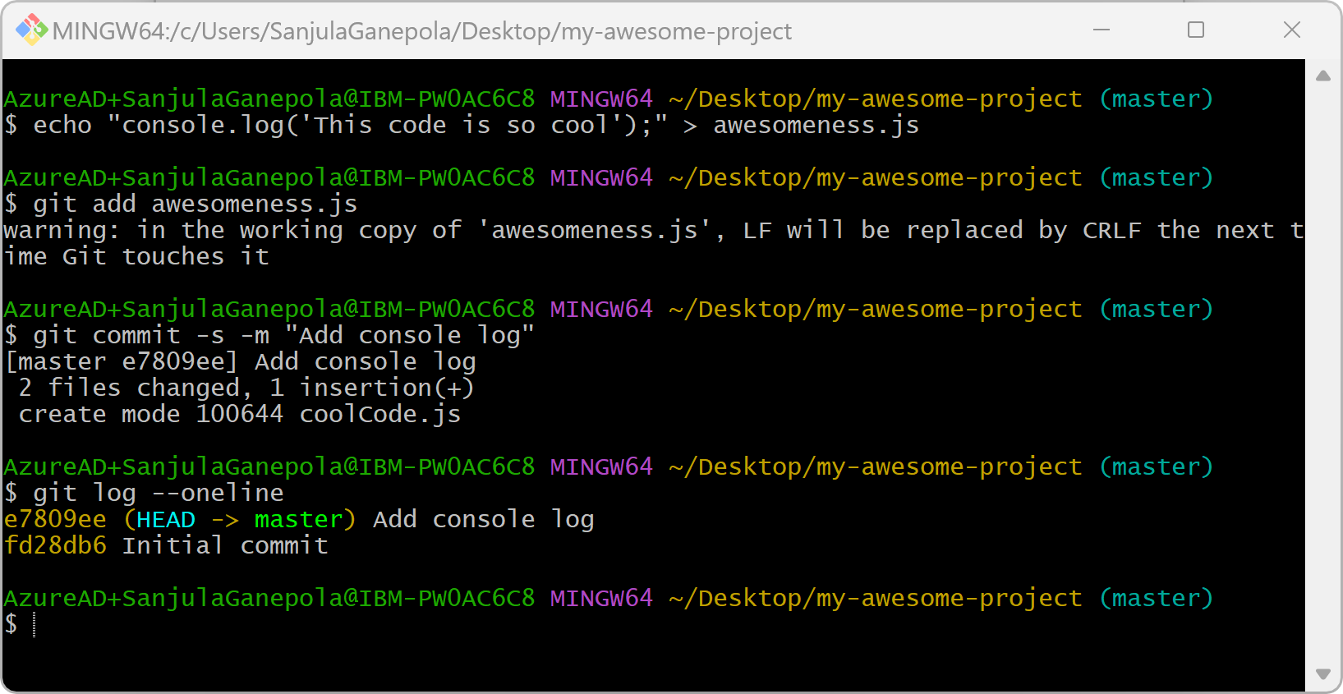
Committing more files
WORKING DIRECTORY
STAGING AREA
LOCAL REPO
REMOTE REPO

Slide 12

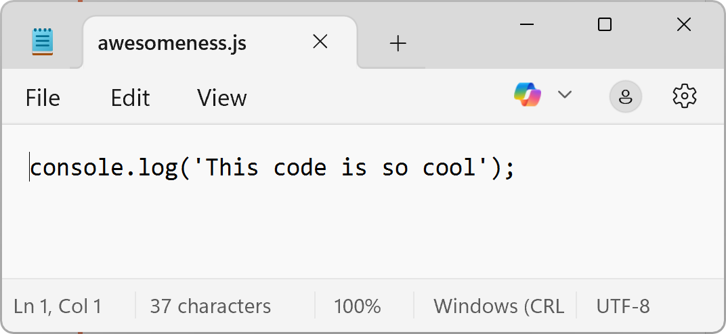
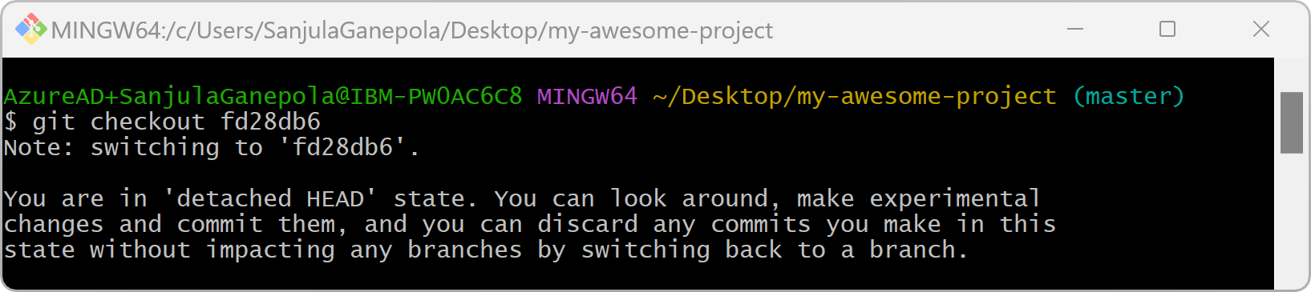
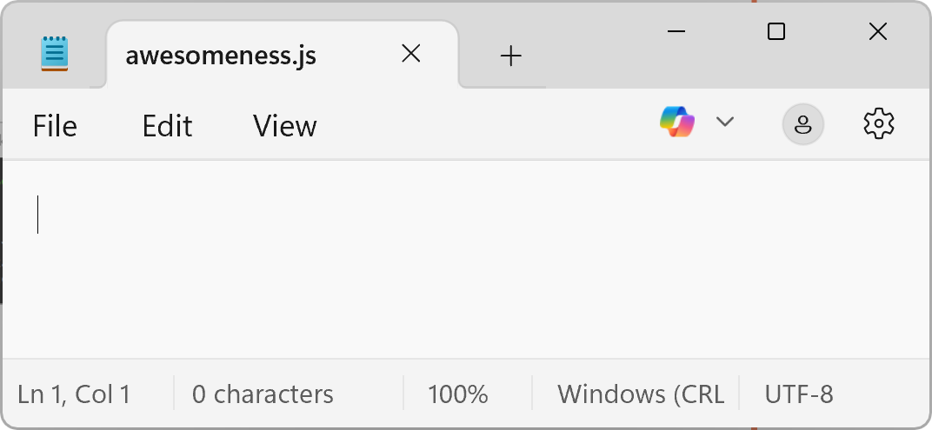
Checking out a specific commit
e7809ee Add console log
fd28db6 Initial commit

Slide 13
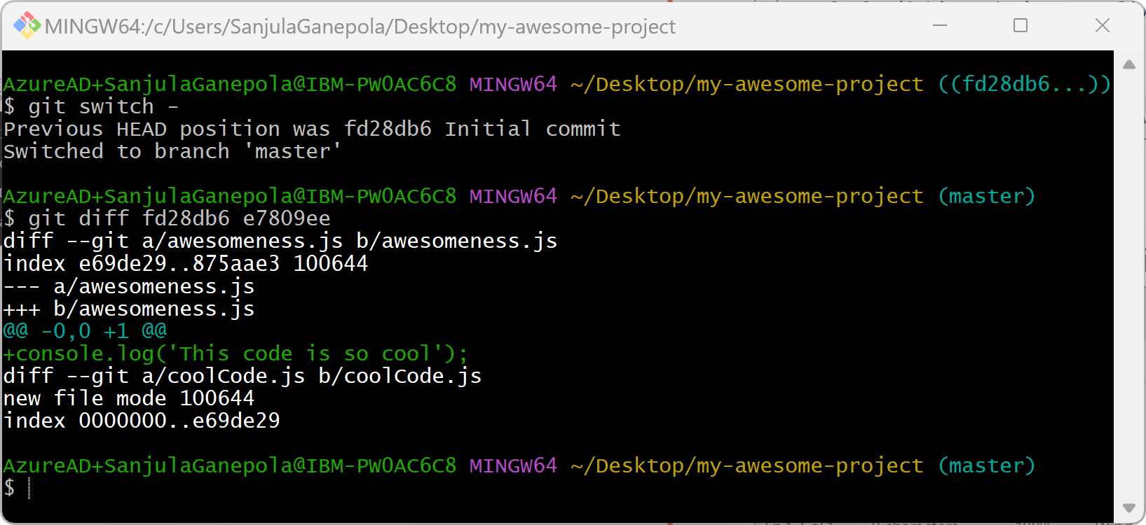
Comparing two commits

Slide 14
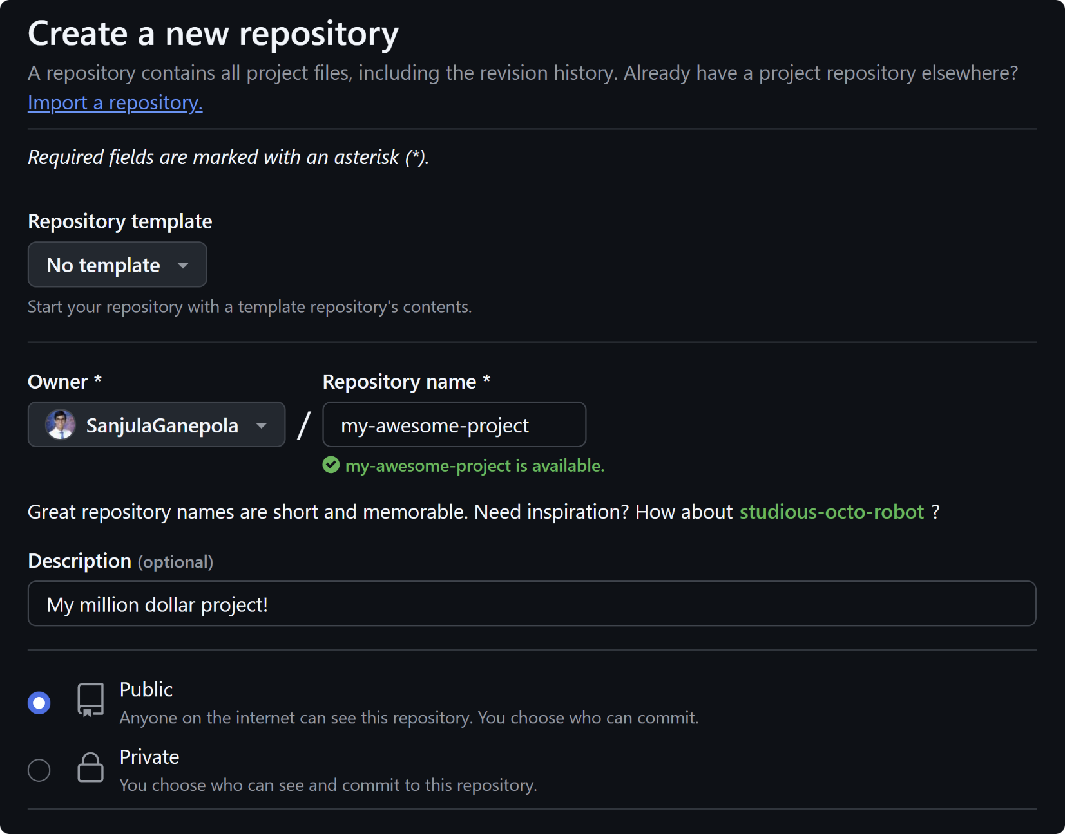

Creating a remote repository

Slide 15
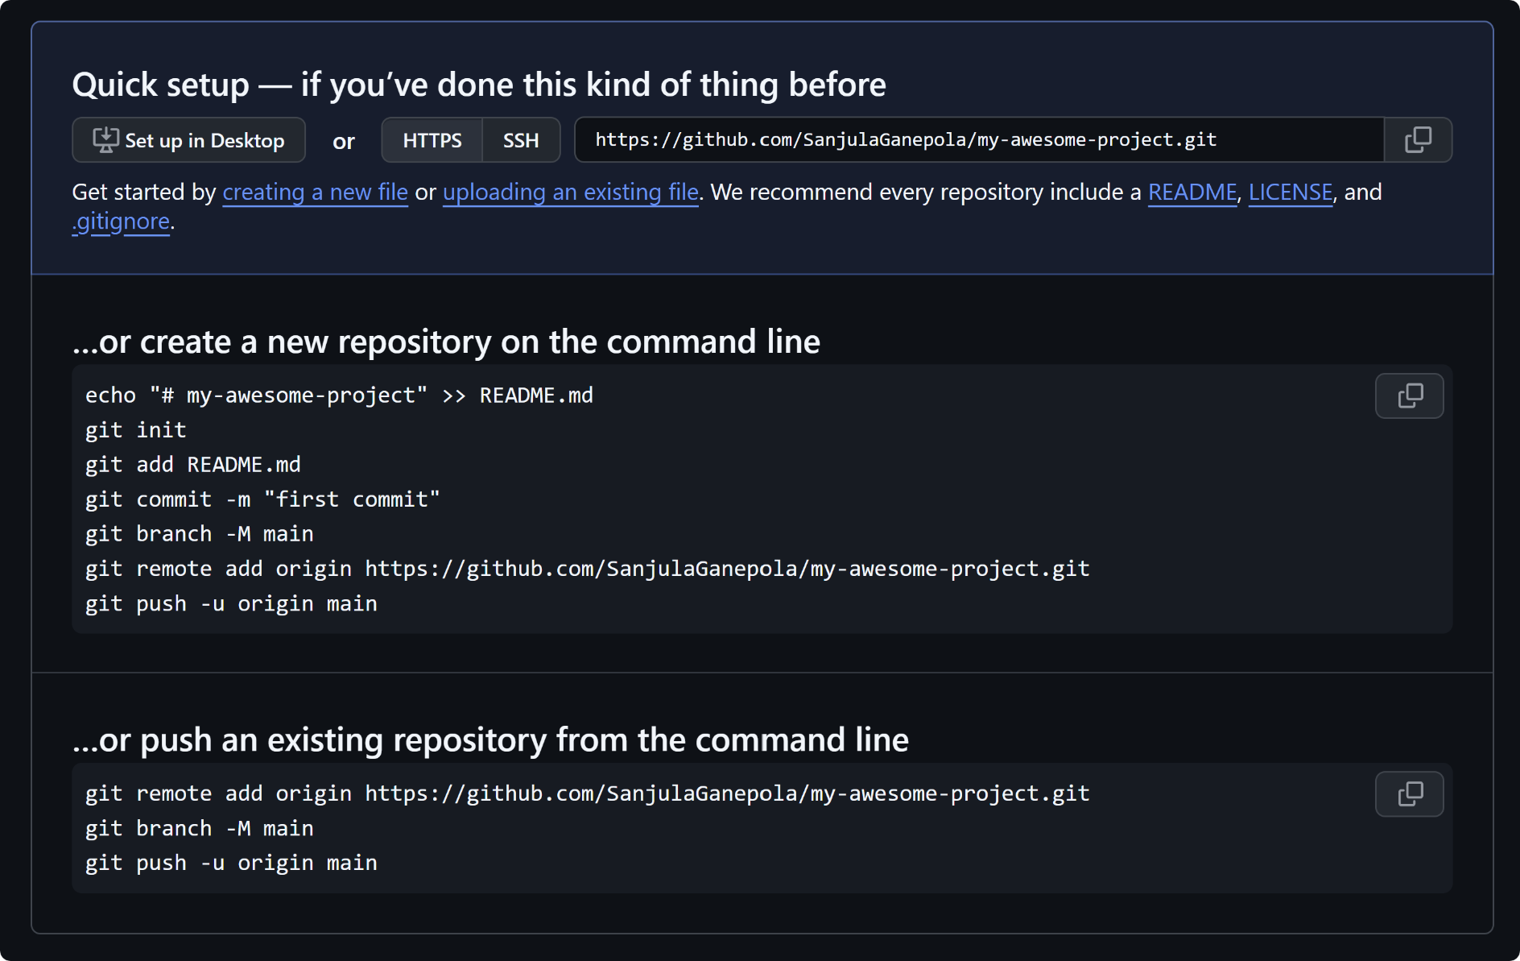
Using the quick setup instructions
https://github.com/SanjulaGanepola/my-awesome-project

Slide 16
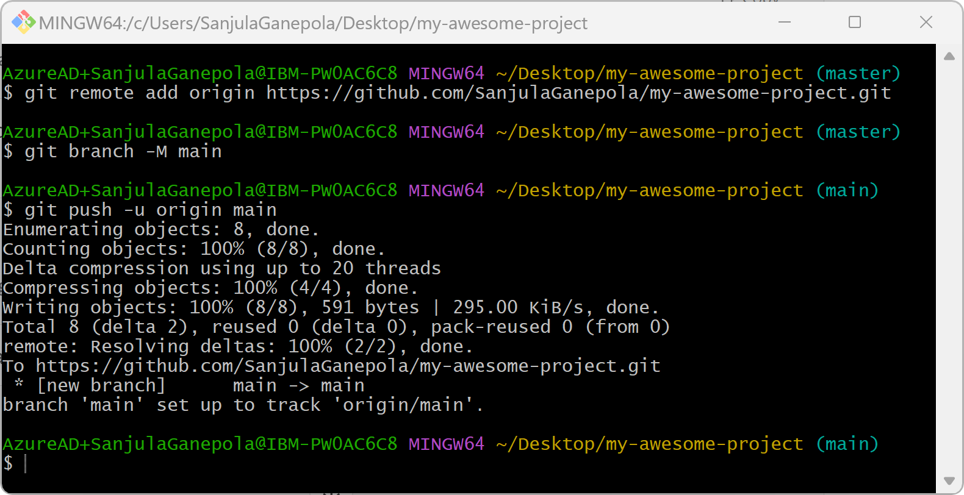
Pushing to the remote repository
WORKING DIRECTORY
STAGING AREA
LOCAL REPO
REMOTE REPO

Slide 17
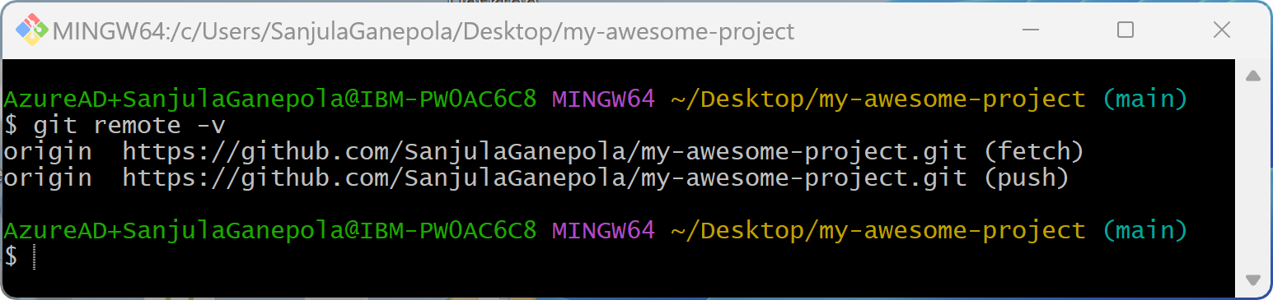
Listing the remote repositories

Slide 18
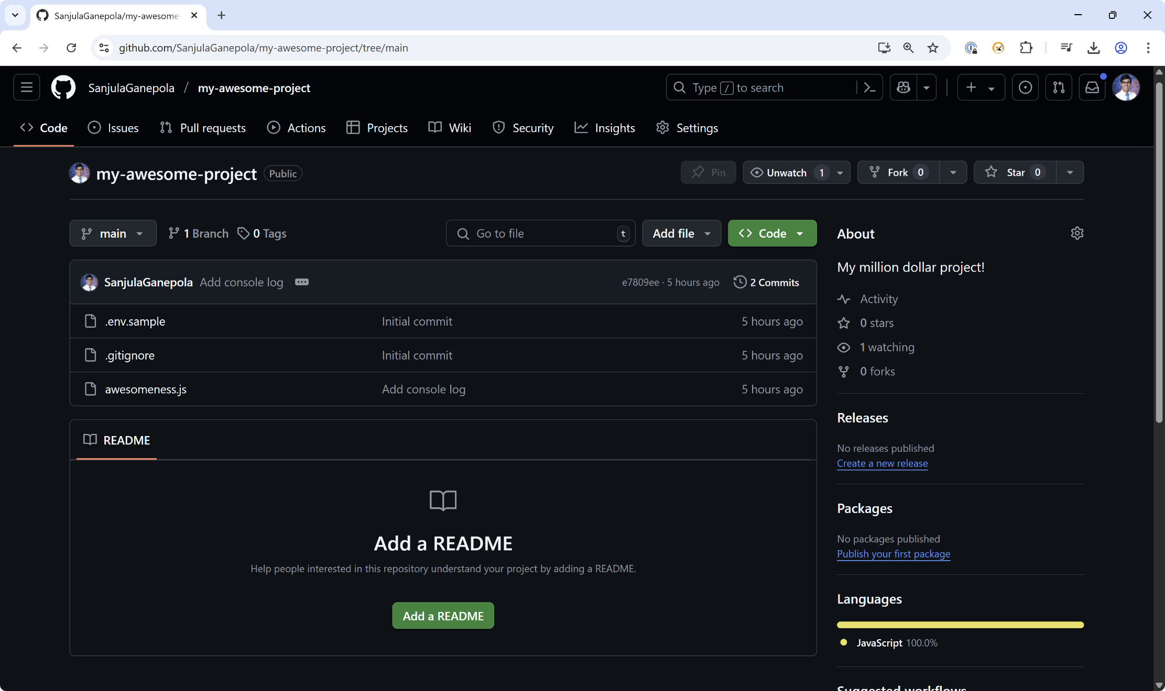
Viewing the remote repository

Slide 19
Using Git in a Team

Slide 20
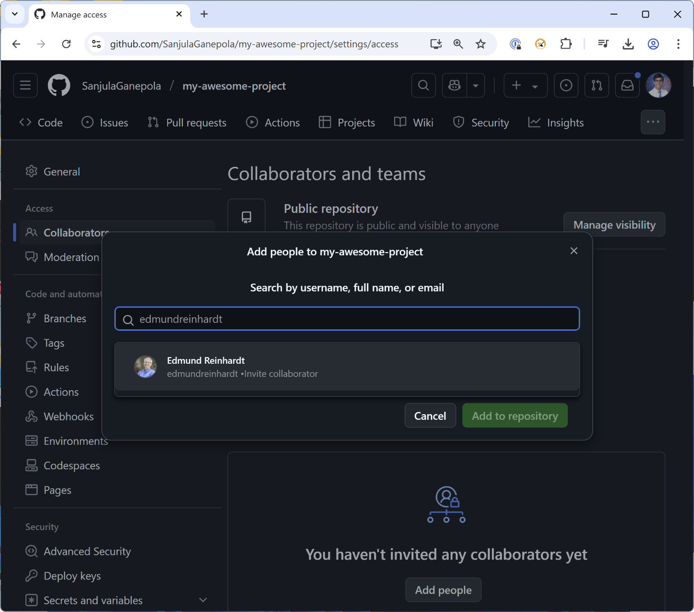
Adding collaborators

Slide 21
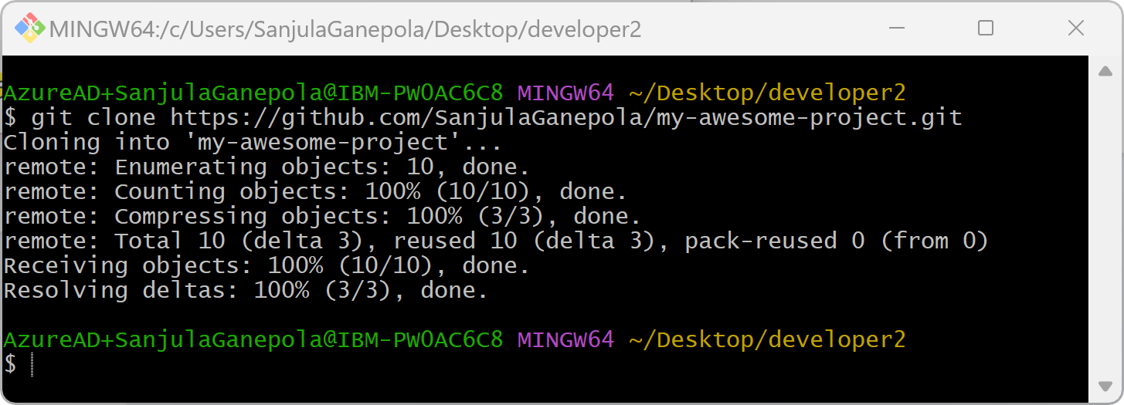
Cloning the remote repository
WORKING DIRECTORY
STAGING AREA
LOCAL REPO
REMOTE REPO
👨‍💻
Edmund (Team Member)

Slide 22
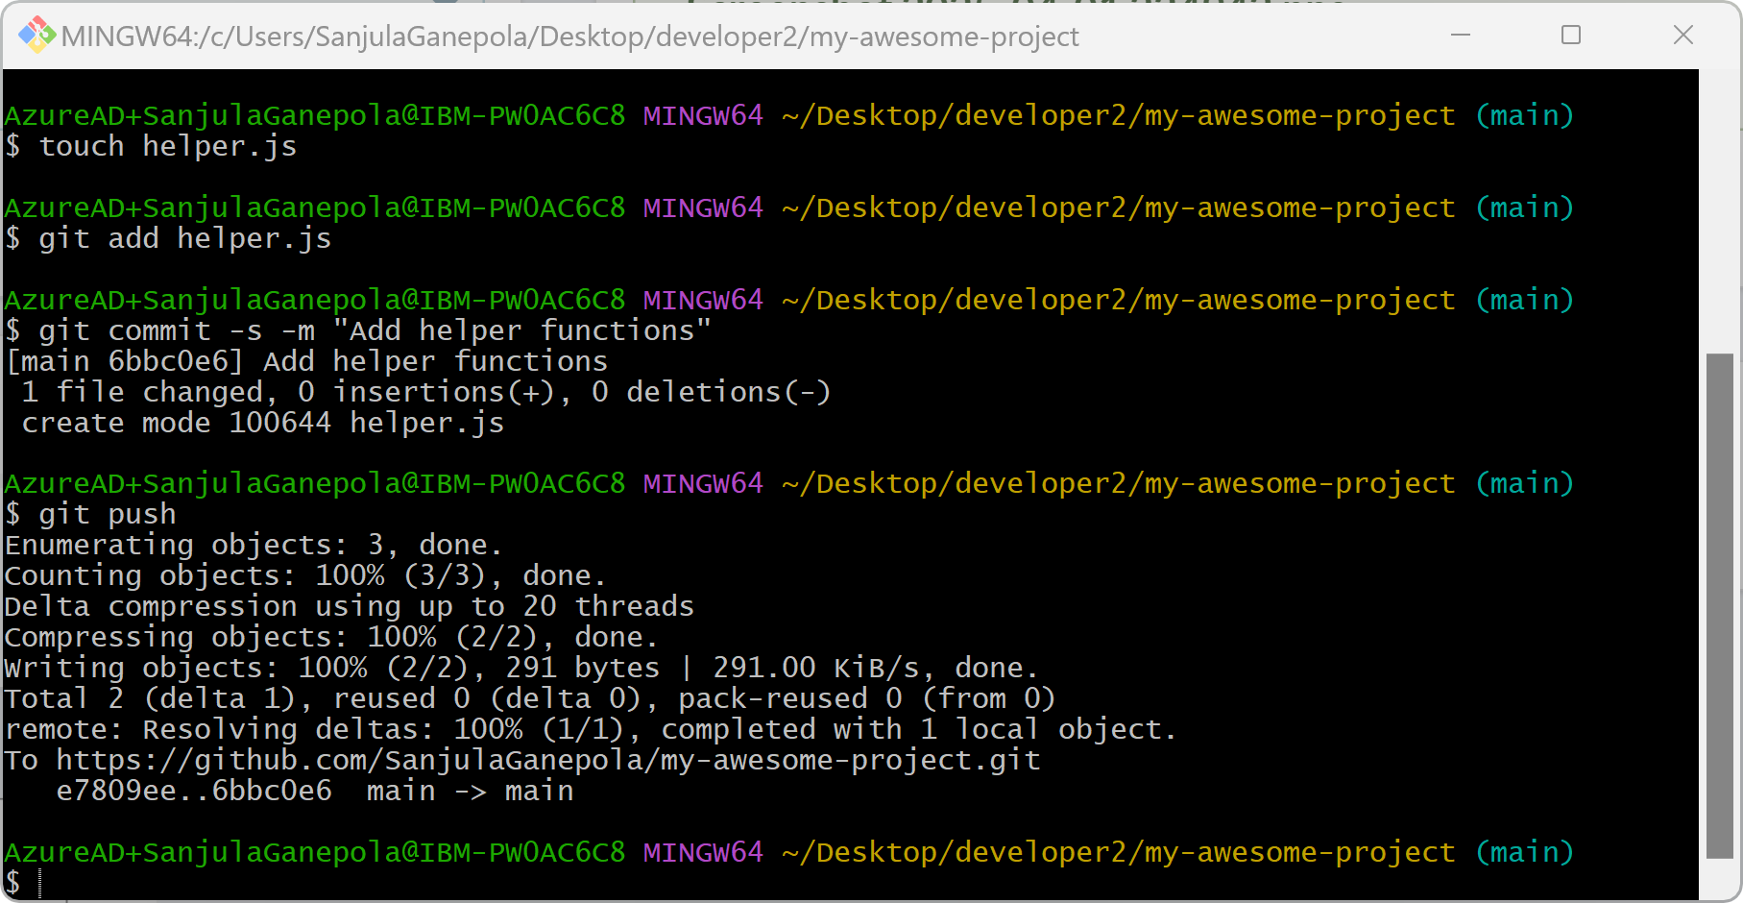
Working → Staging → Committing → Pushing
WORKING DIRECTORY
STAGING AREA
LOCAL REPO
REMOTE REPO
👨‍💻
Edmund (Team Member)

Slide 23
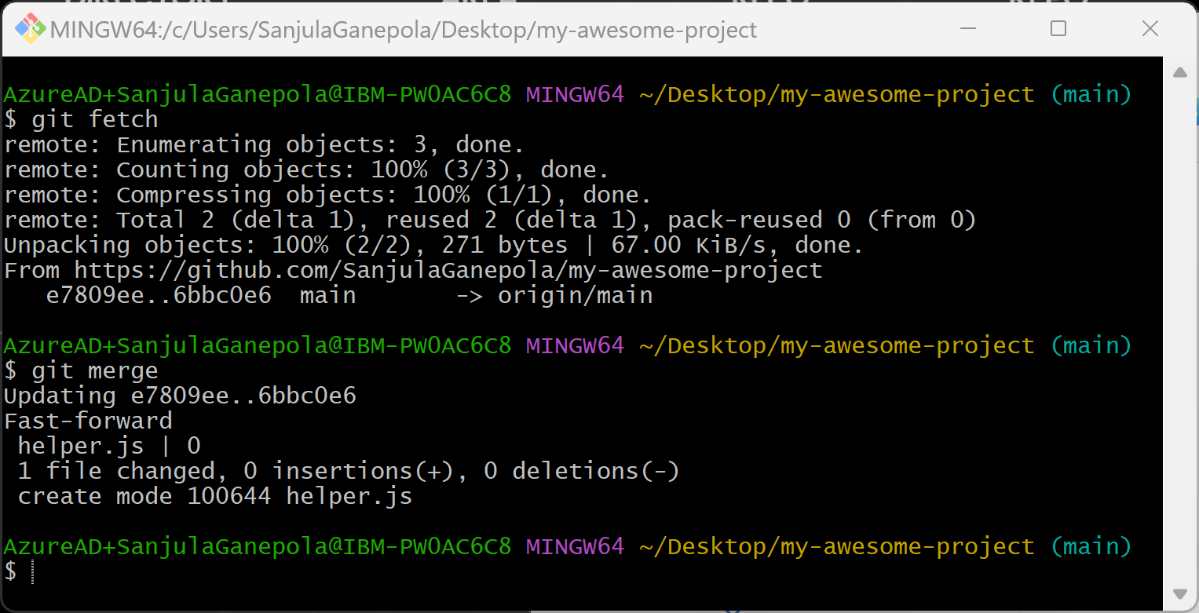
Option 1: Fetching and merging from the remote repository
WORKING DIRECTORY
STAGING AREA
LOCAL REPO
REMOTE REPO
MERGE
FETCH
👨‍💻
Sanjula (Owner)

Slide 24
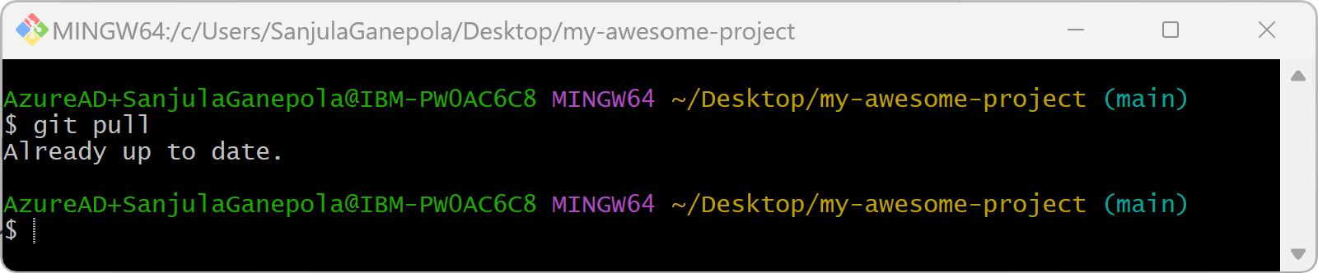
Option 2: Pulling from the remote repository
WORKING DIRECTORY
STAGING AREA
LOCAL REPO
REMOTE REPO
PULL
👨‍💻
Sanjula (Owner)

Slide 25
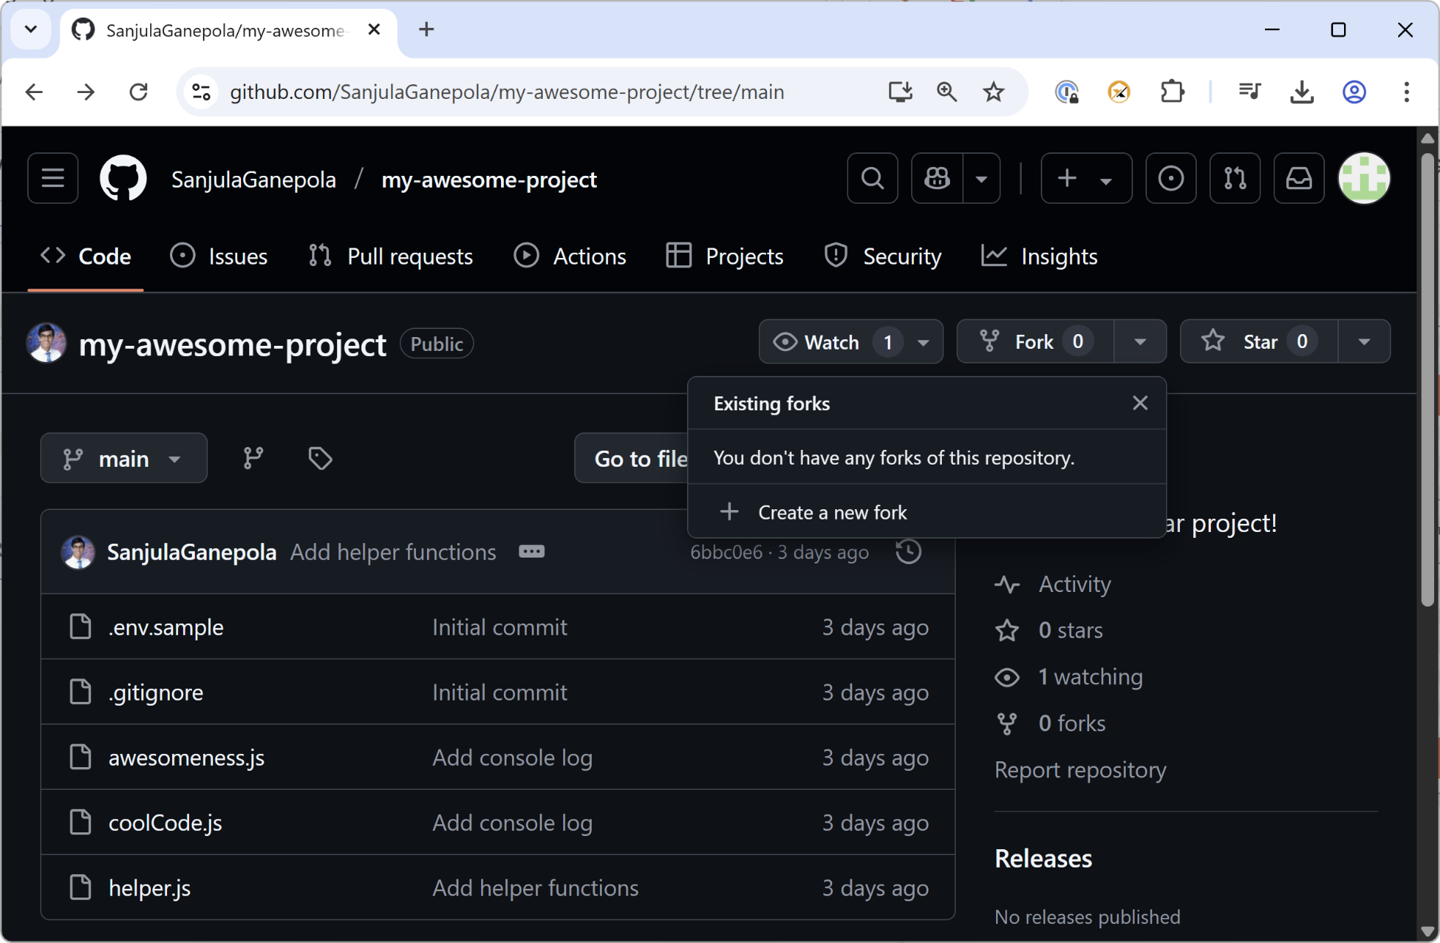
Creating a fork
👨‍💻
John (Outside Collaborator)

Slide 26
Upstream vs. Origin
Remote GitHub Repo - Original
Remote GitHub Repo - Fork
upstream
origin
Local Repo

Slide 27
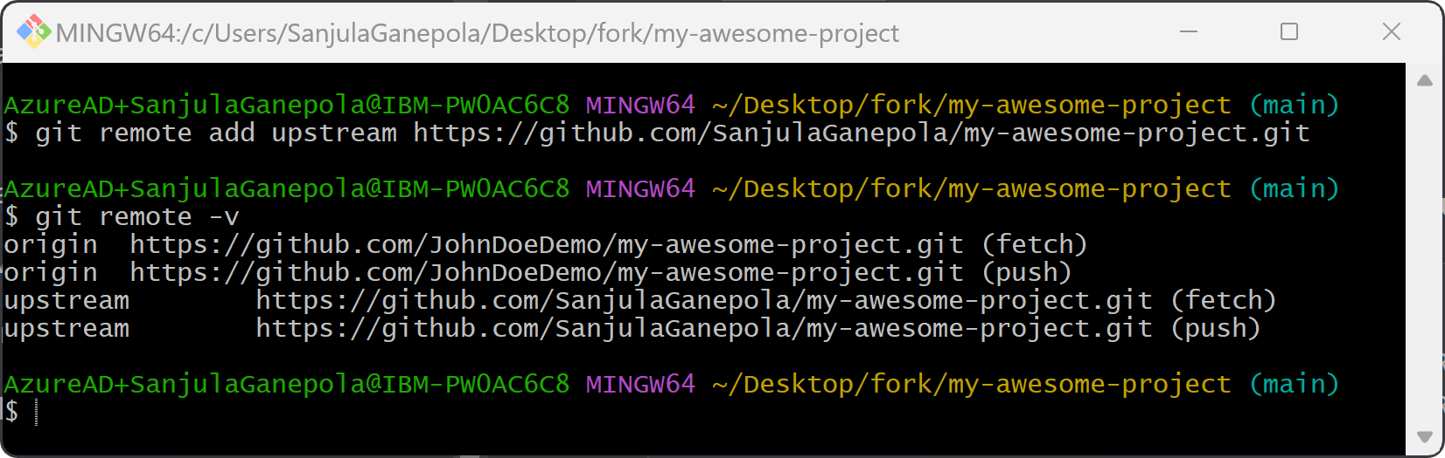
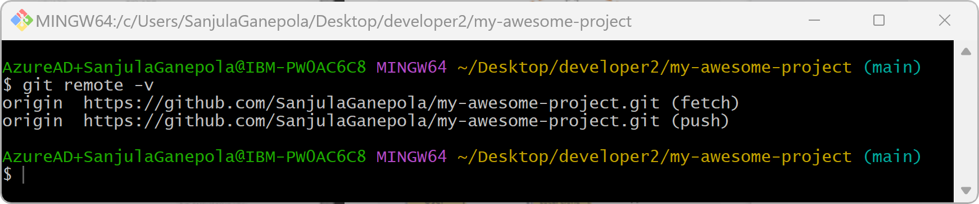
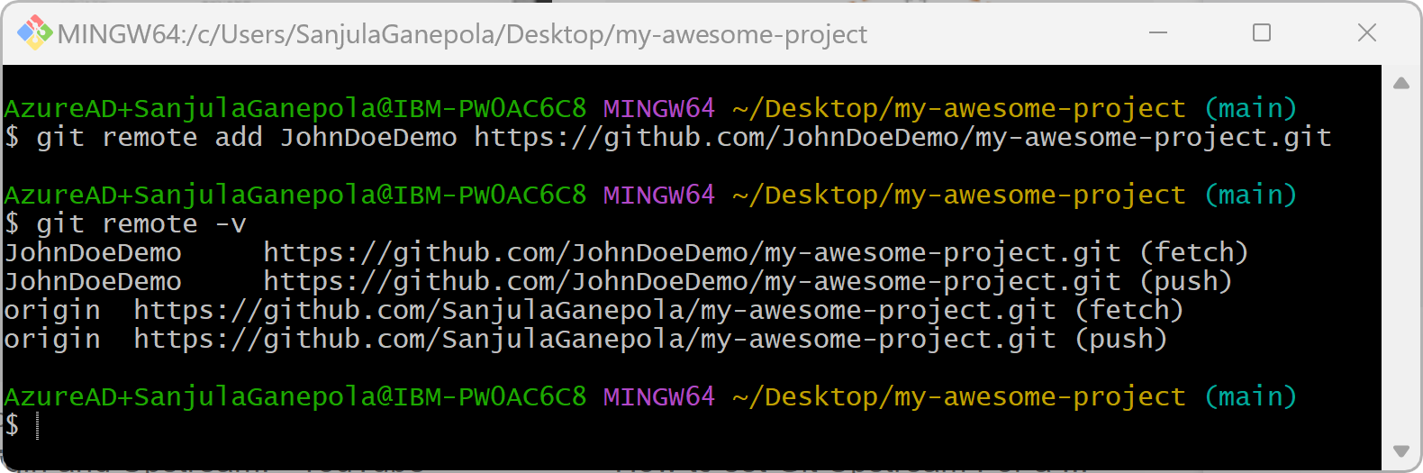
Listing Remote Repositories
👨‍💻
John (Outside Collaborator)
👨‍💻
Edmund (Team Member)
👨‍💻
Sanjula (Owner)

Slide 28
Branching and Merge Conflicts

Slide 29
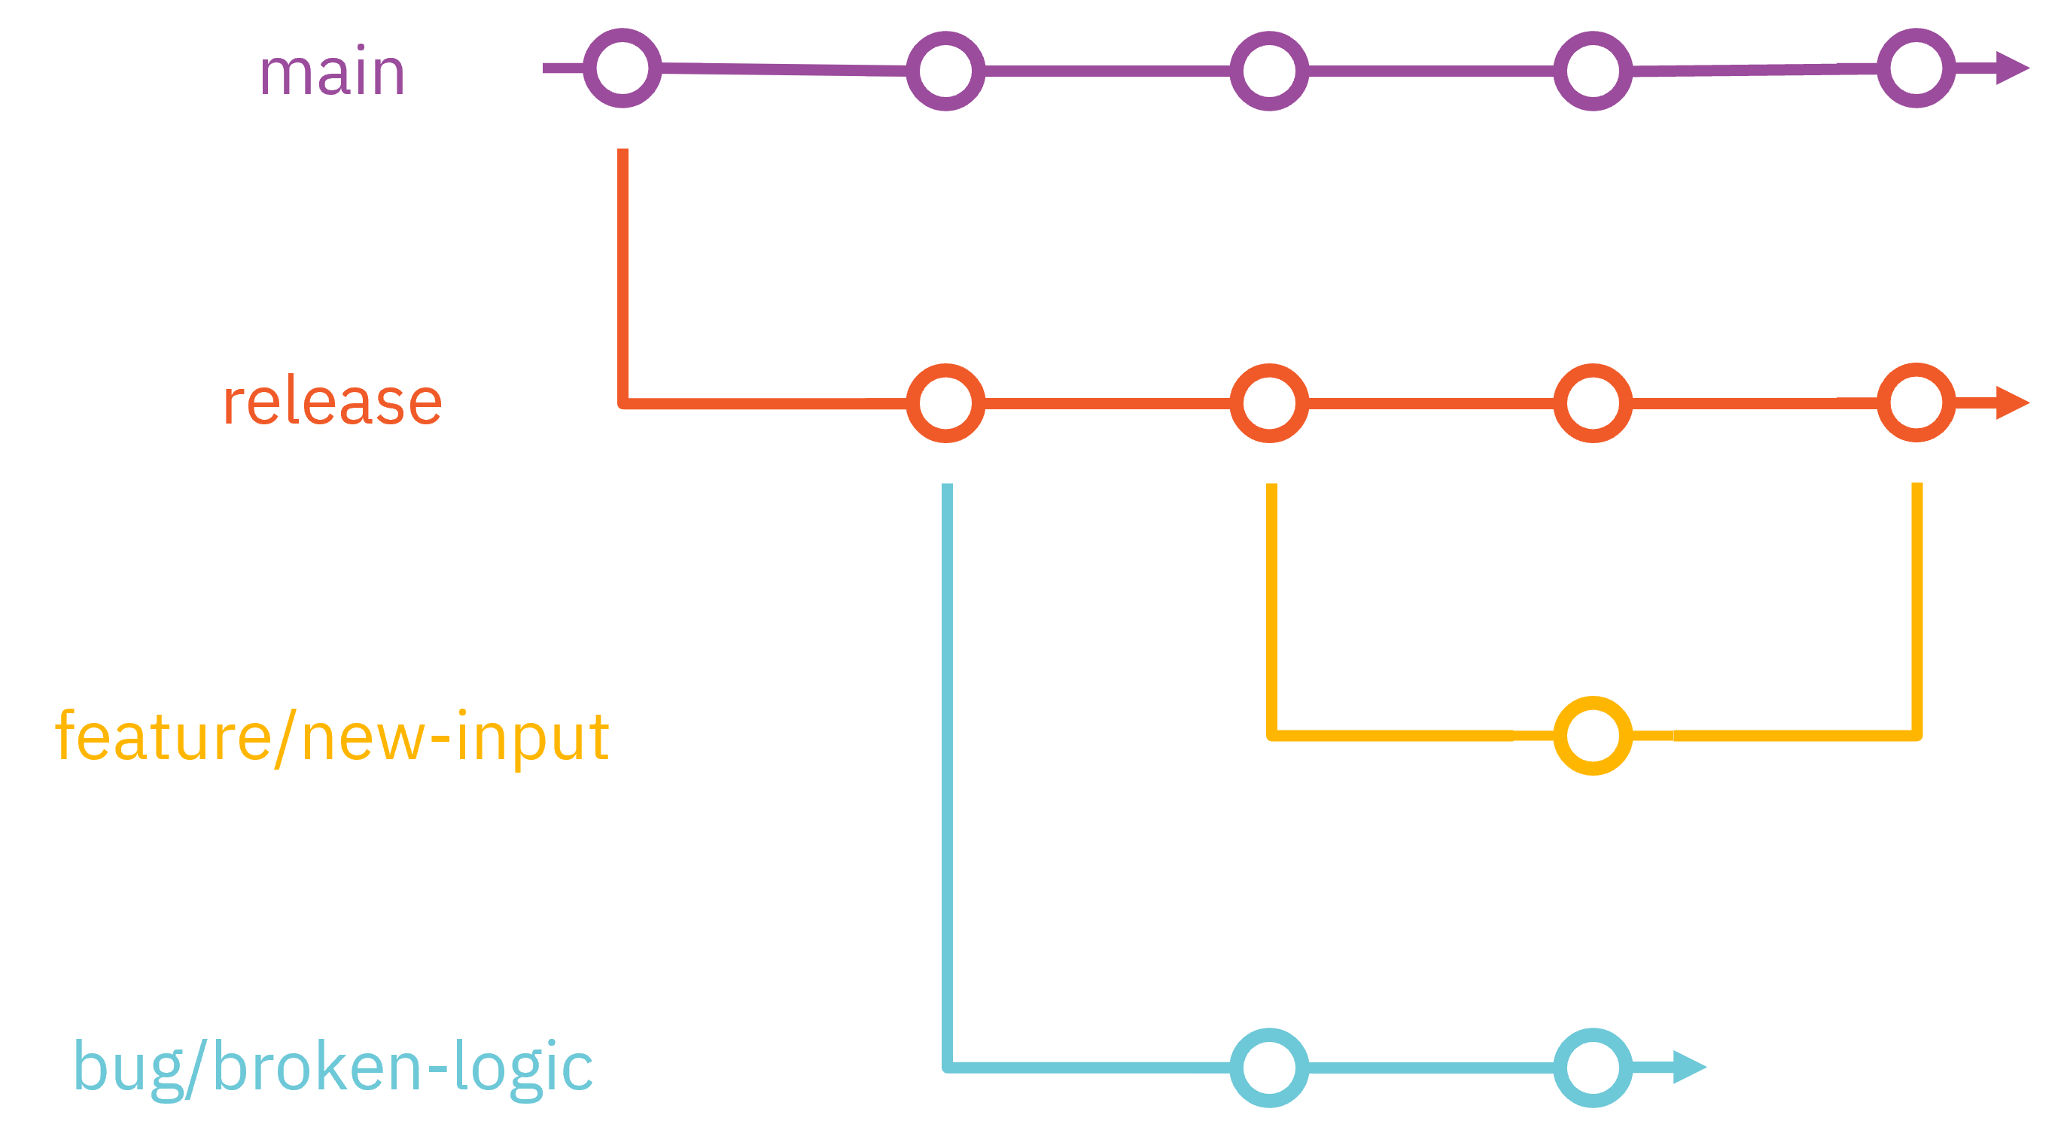
Branching in Git

Slide 30
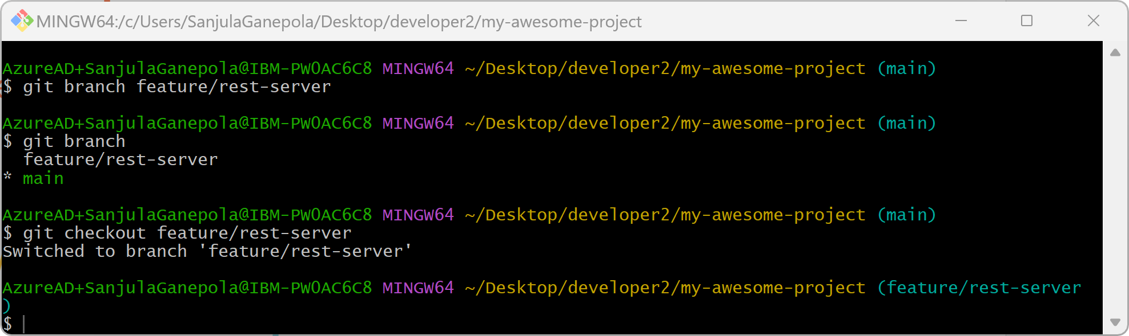
Creating and checking out a branch

Slide 31
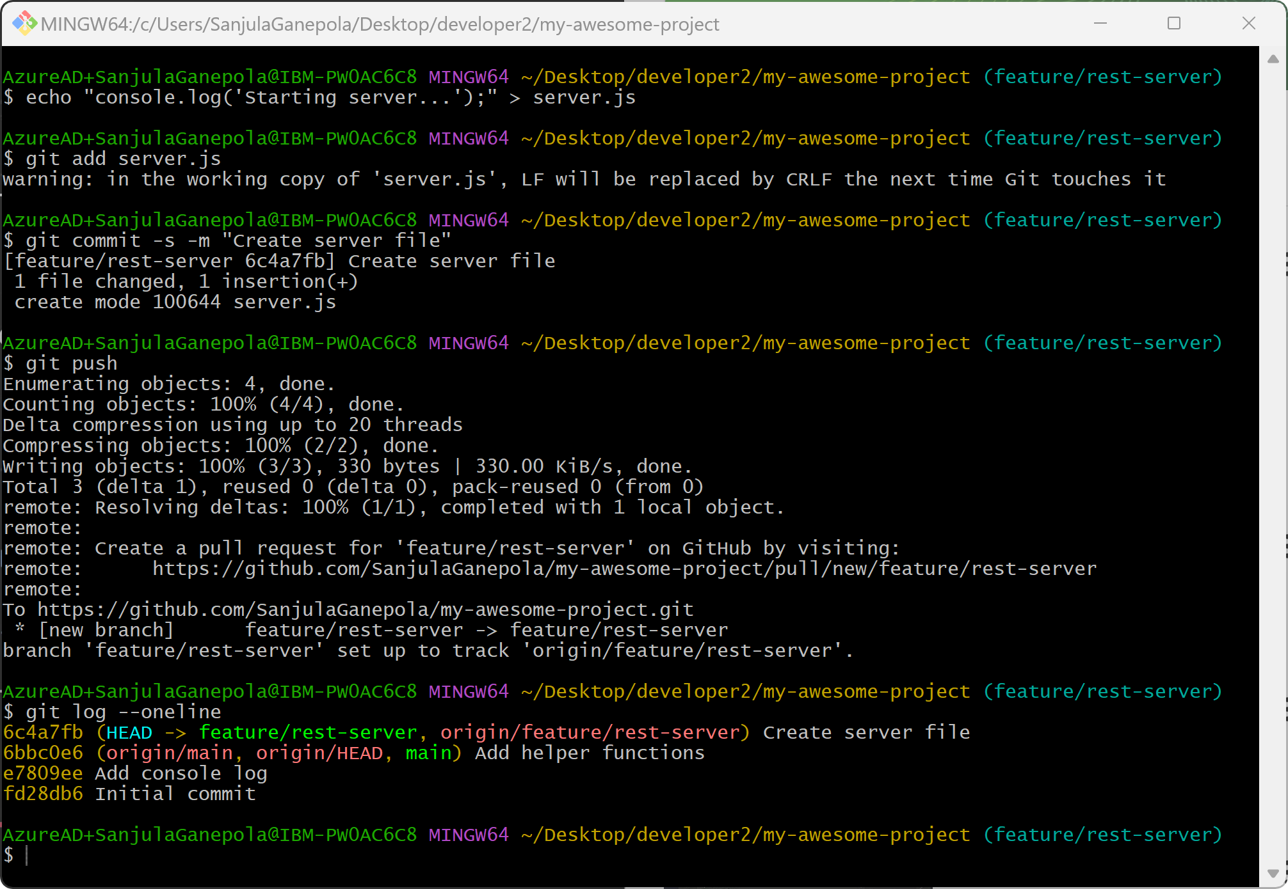
Pushing to the branch
feature/rest-server
Create server file
main
Add helper functions
Add console log
Initial commit

Slide 32
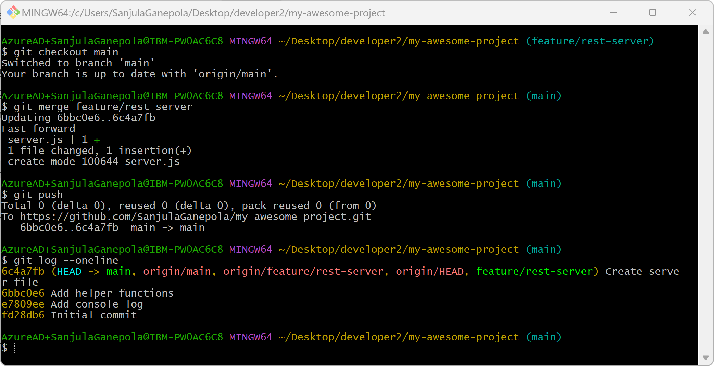
Merging branches

Slide 33
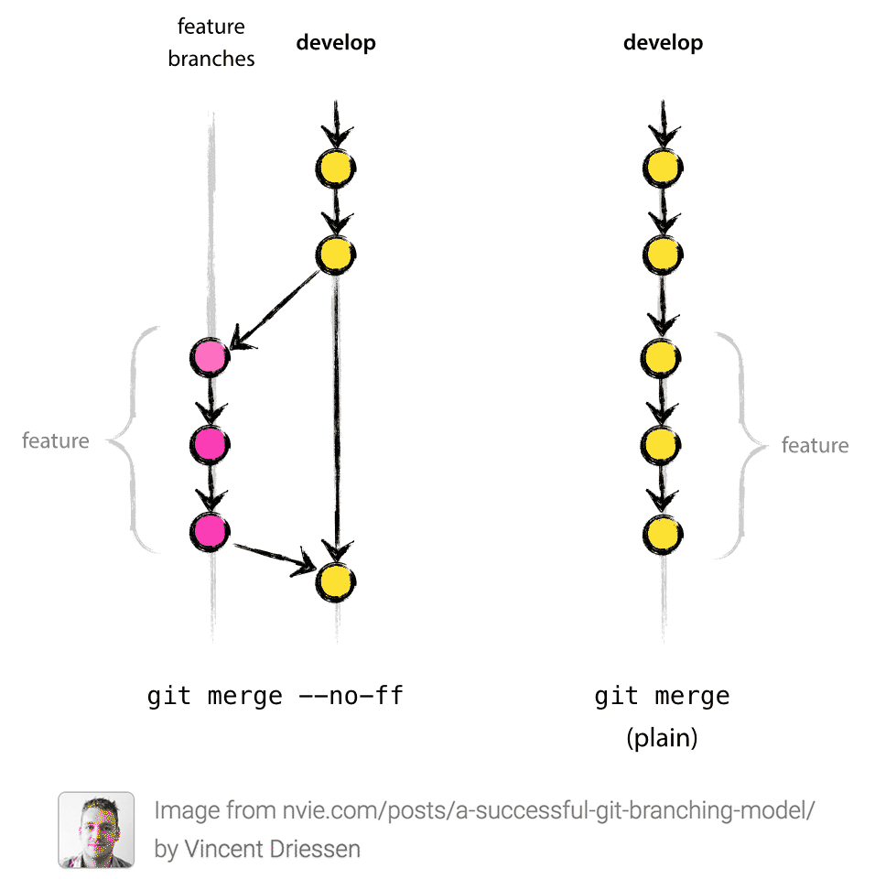
Fast forward merge vs non-fast forward merge

Slide 34
When can merge conflicts happen?
main
A
B
C
fix/bug-123
X
Y

Slide 35
3-way merge
main
A
B
C
fix/bug-123
X
Y
Current changes
C
diff
B
Δ1
Incoming changes
Y
diff
B
Δ2

Slide 36
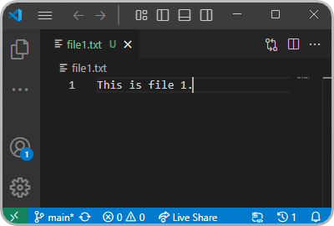

Scenario 1: No file overlap

Slide 37
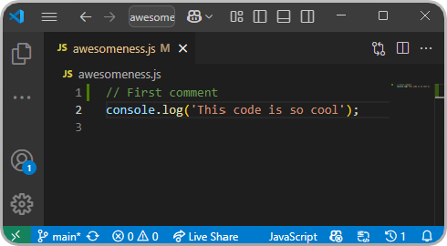
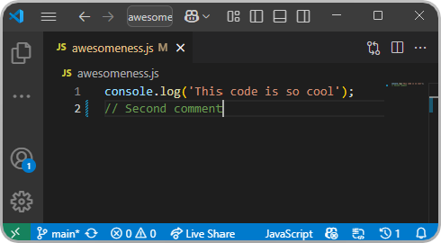
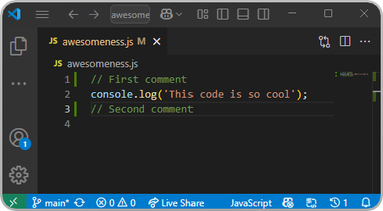
Scenario 2: No line overlap

Slide 38
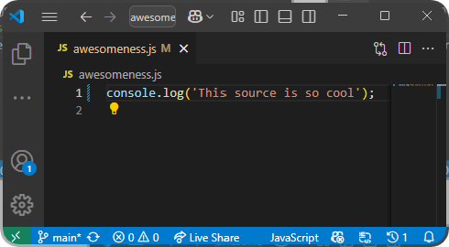
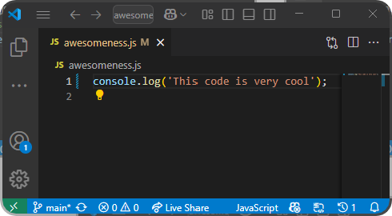
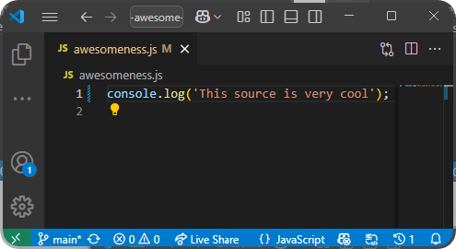
Scenario 3: Line overlap

Slide 39
Merge commit
main
A
B
C
D
fix/bug-123
X
Y
Merge fix/bug-123 onto main with a merge commit

Slide 40
Merge Commits vs. Rebase Merging vs. Squash Merging

Slide 41
Merge commits
main
A
B
C
D
fix/bug-123
X
Y
Merge fix/bug-123 onto main with a merge commit

Slide 42
Rebase merging
main
A
B
C
fix/bug-123
X
Y
Append commits in fix/bug-123 onto the front of main
main
A
B
C
X’
Y’

Slide 43
Squash merging
main
A
B
C
fix/bug-123
X
Y
Combine commits in fix/bug-123 into a single commit and append onto the front of main
main
A
B
C
D

Slide 44
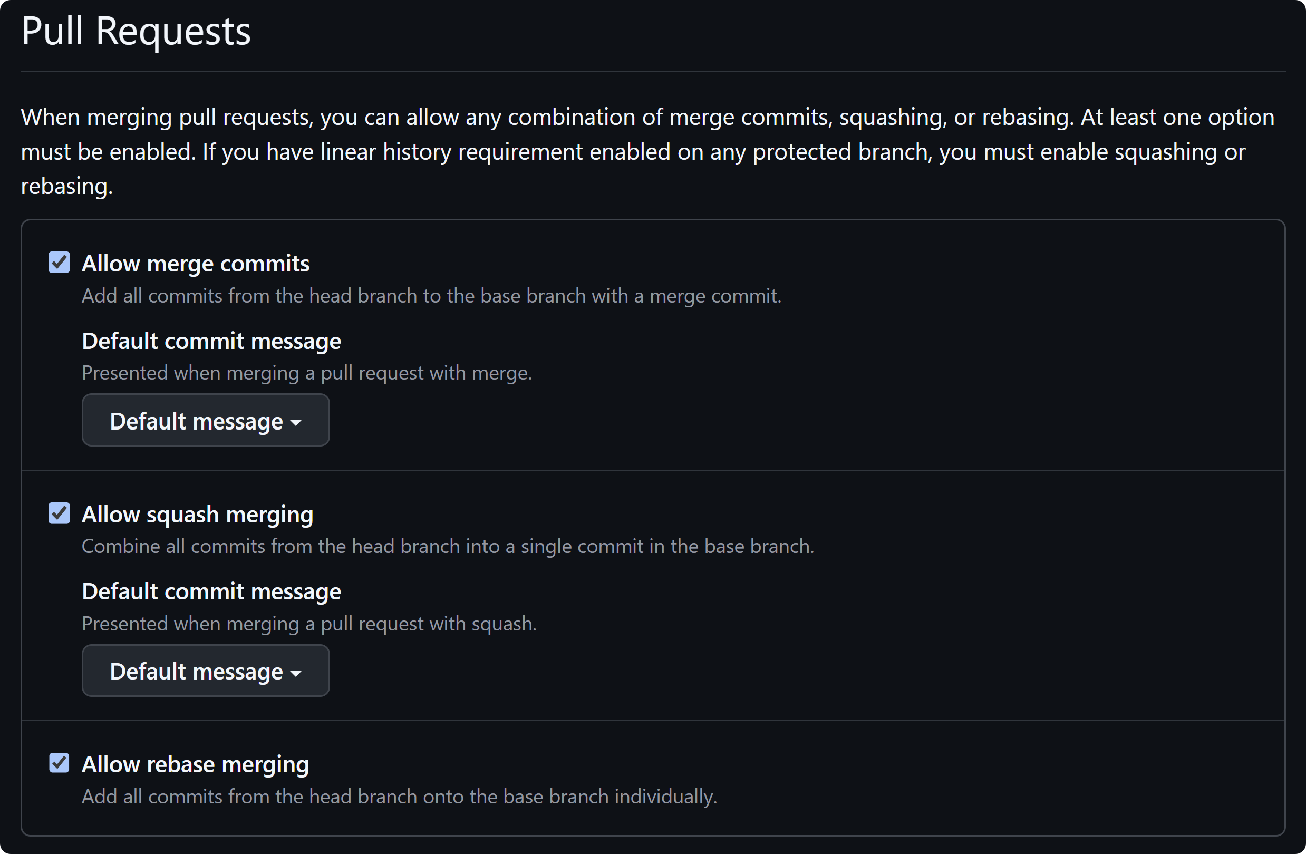
Pull request settings

Slide 45
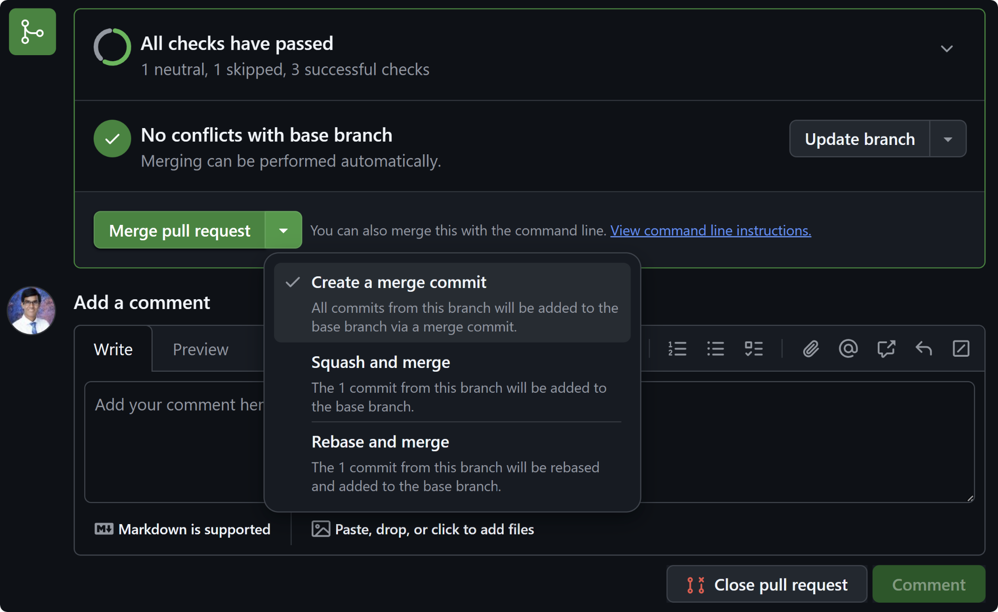
Pull request merge options

Slide 46
Tips and Tricks

Slide 47
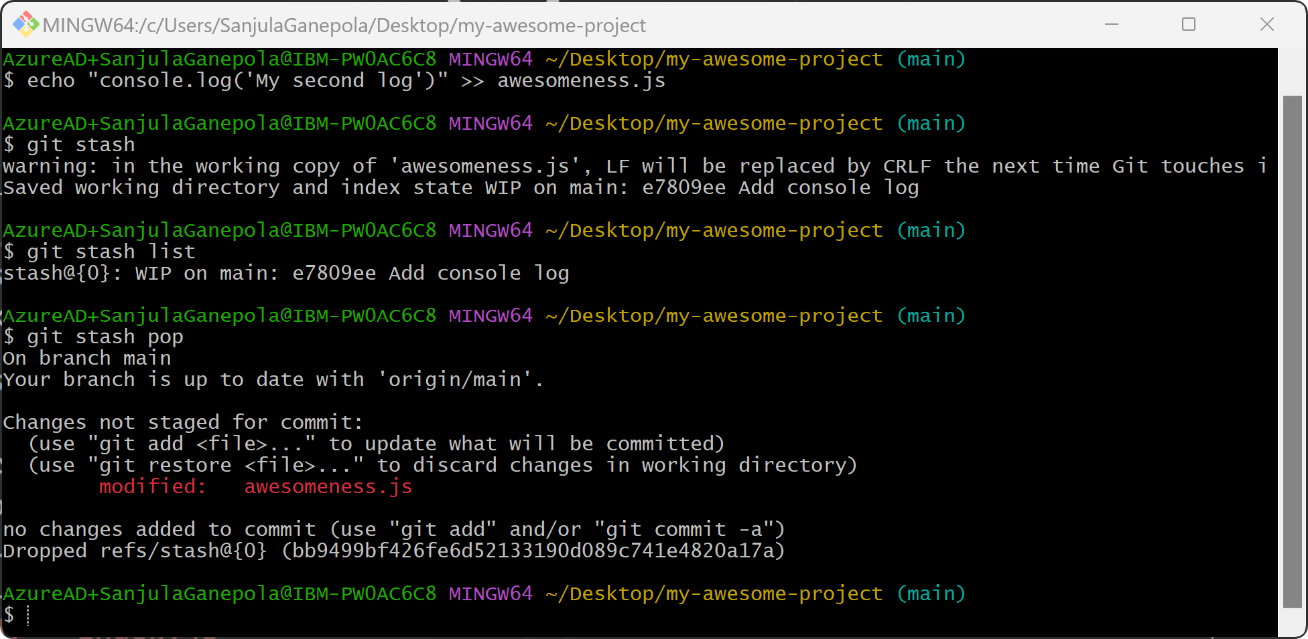
Stashing changes temporarily

Slide 48
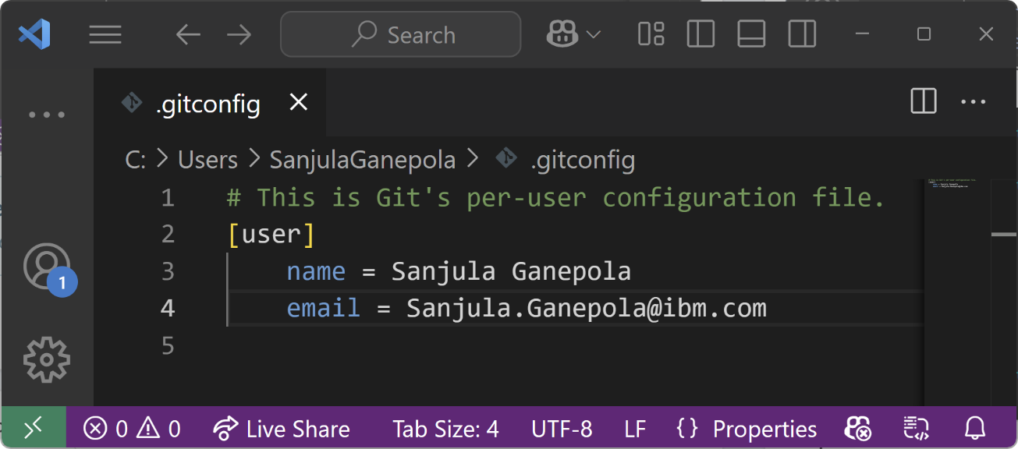
Git Configs
Scopes of configuration
System: System-wide configuration
C:\Program Files\Git\etc\gitconfig
/etc/gitconfig
Global: User specific configuration
C:\Users\<user>\.gitconfig
/home/<user>/.gitconfig
Local: Repository specific configuration
<git_repo>/.git/config
Git Config Docs: https://git-scm.com/docs/git-config

Slide 49
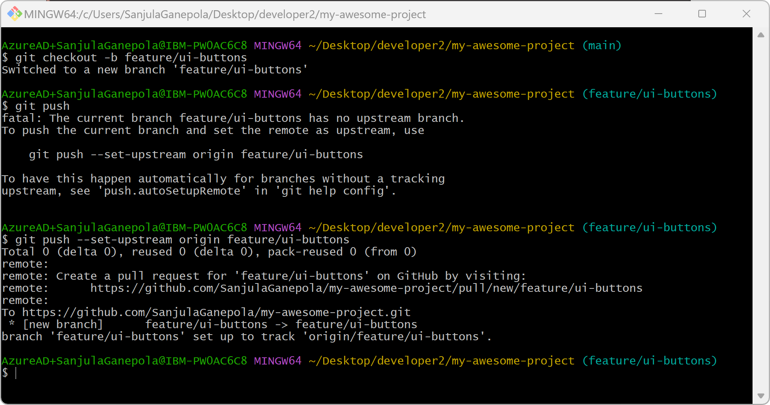
Without auto setup remote branch config

Slide 50
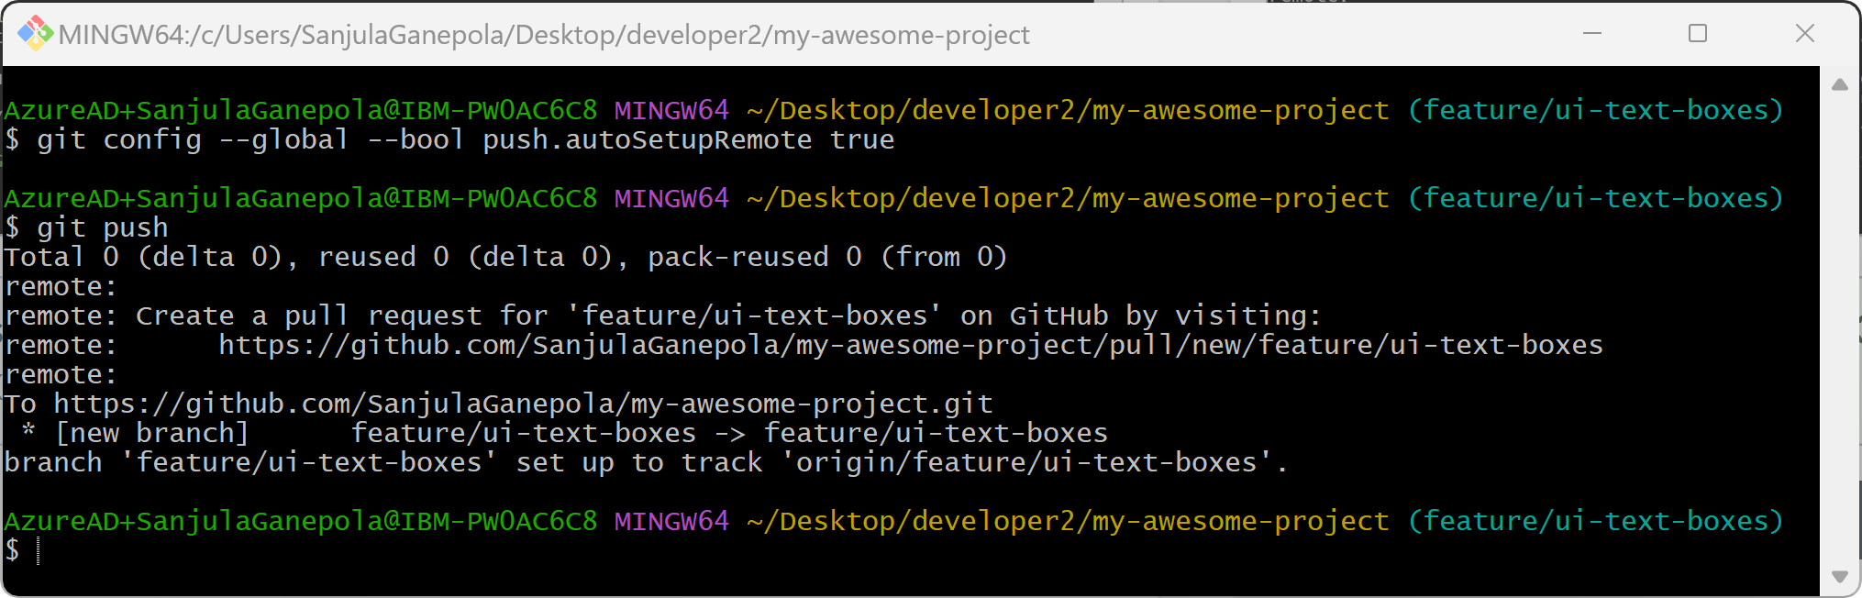
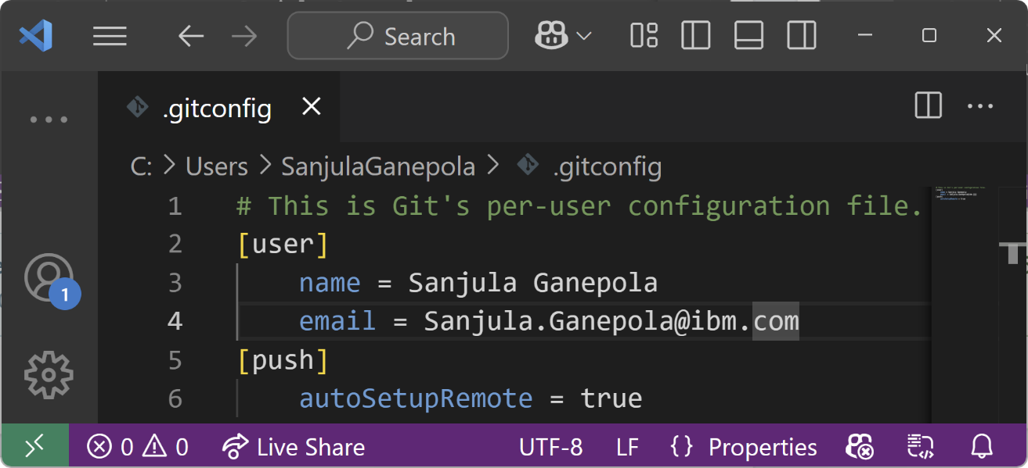
With auto setup remote branch config

Slide 51
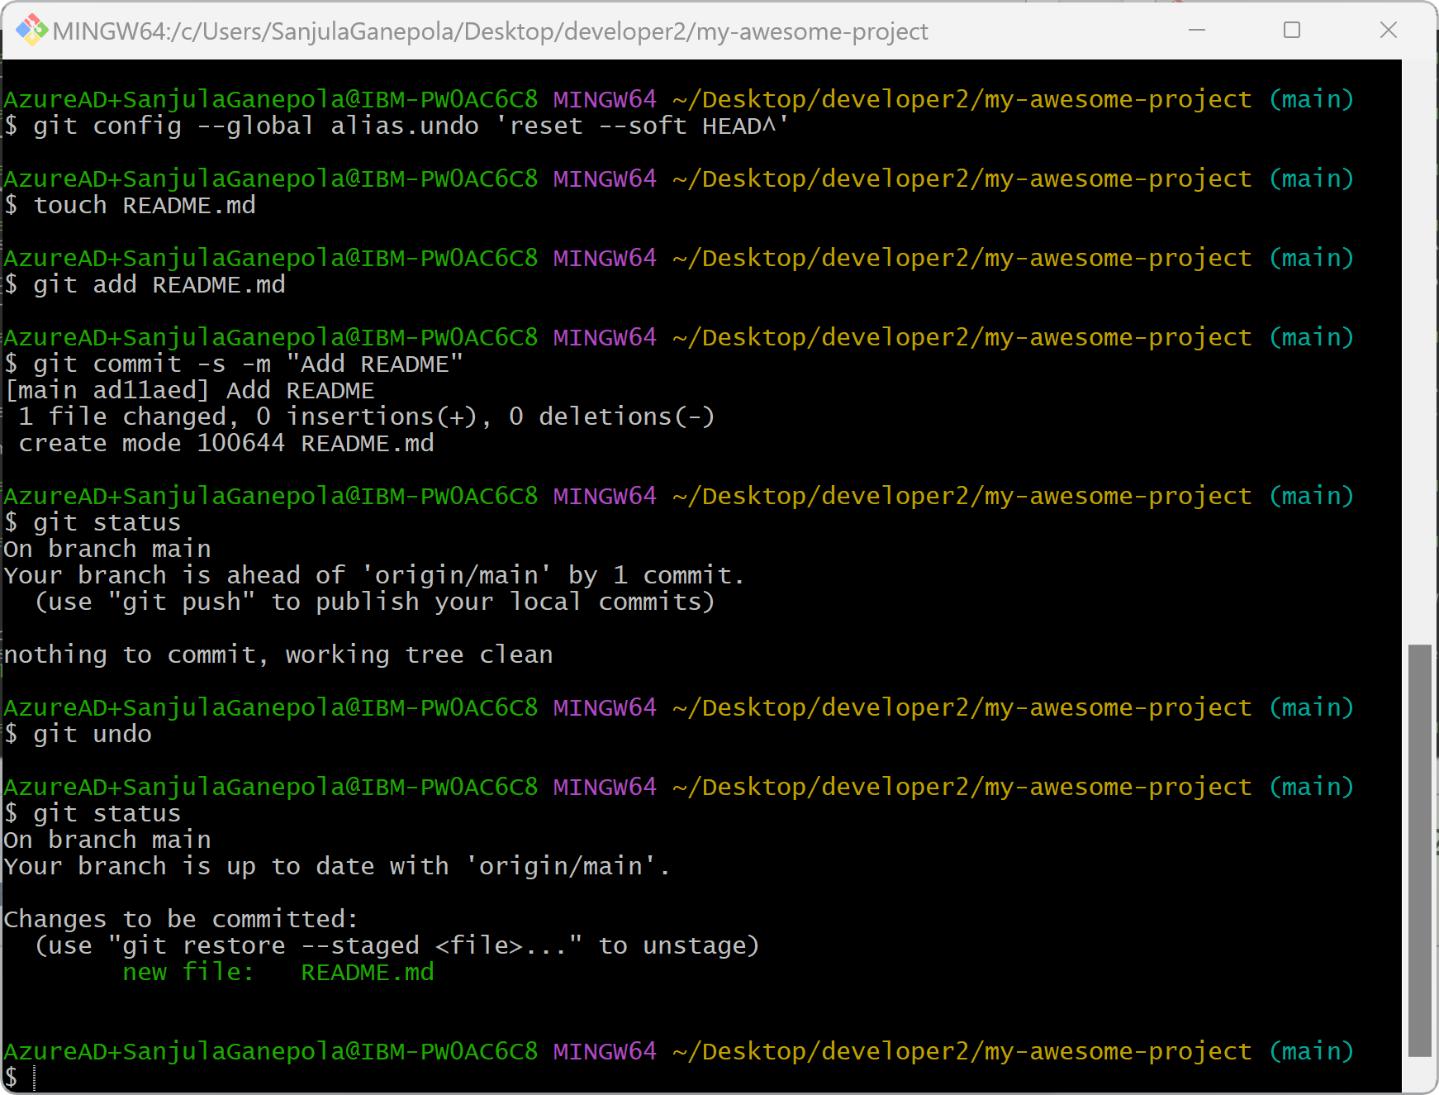
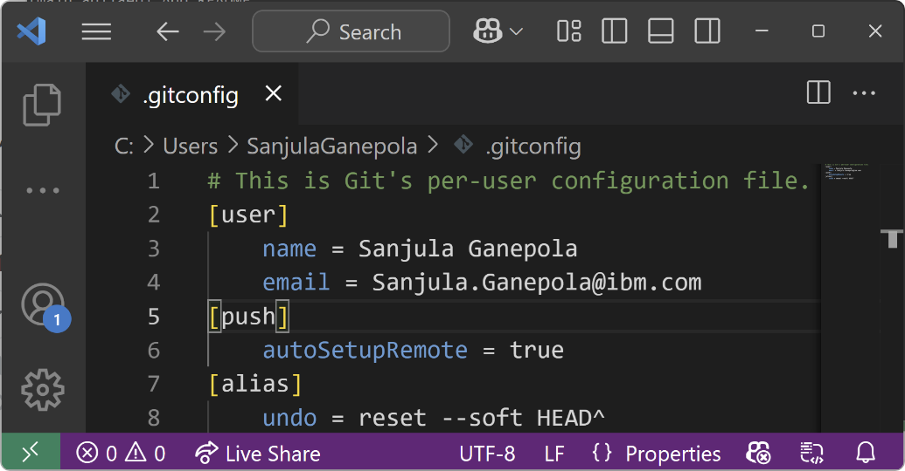
Alias to undo commits

Slide 52
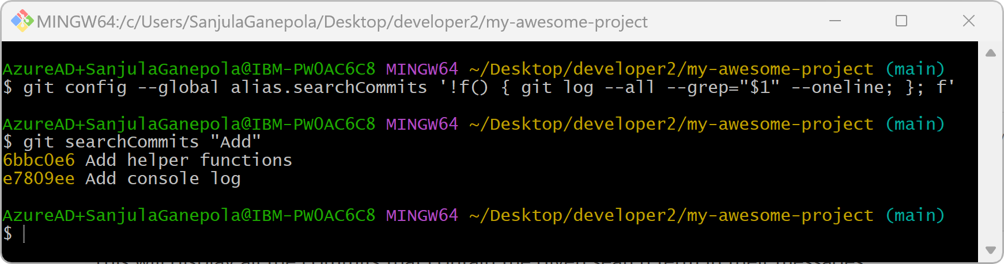
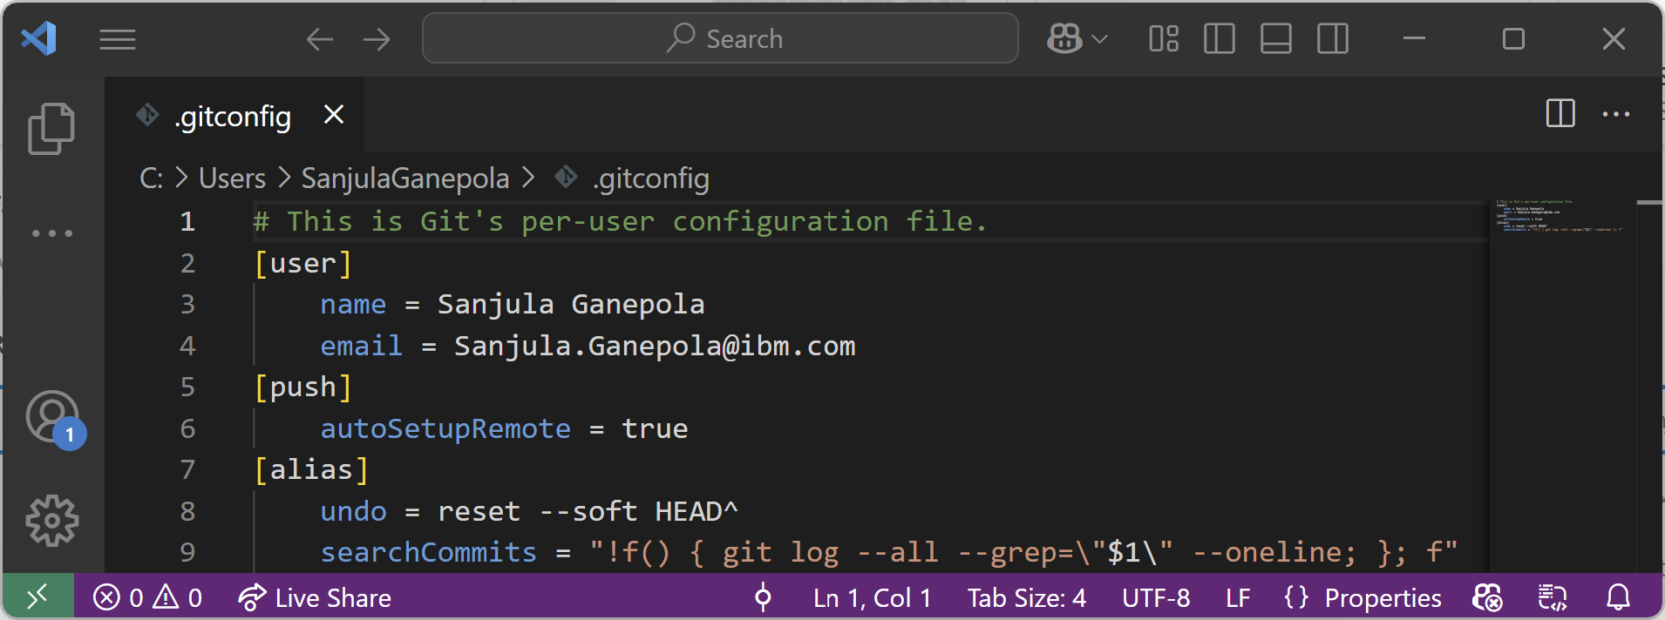
Alias to search all commits for a message

Slide 53
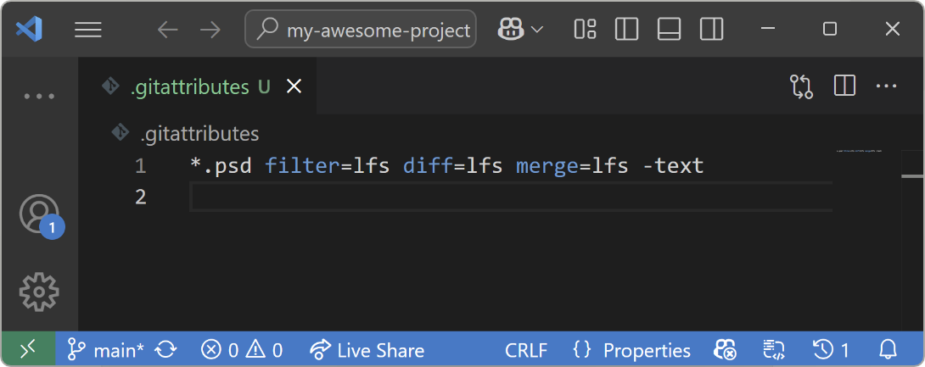
Git Large File Storage (LFS)
Open-source Git extension for versioning large files!
↪ Git LFS handles large files by storing references to the file in the repository, but not the actual file itself.
Install: Run git lfs install on your PC.
Track File Types: Run git lfs track "*.psd"
Track .gitattributes: git add .gitattributes
Use Git as normal!
Git LFS Docs: https://git-lfs.com/

Slide 54
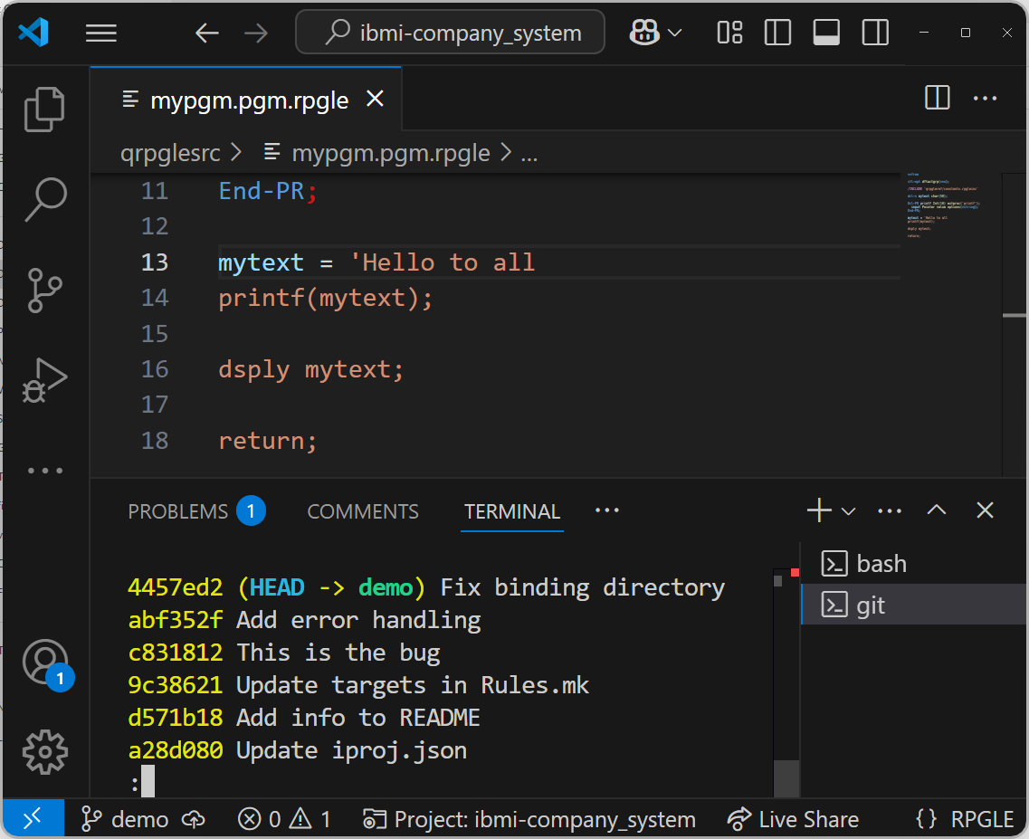
Git bisect
🚨

Slide 55
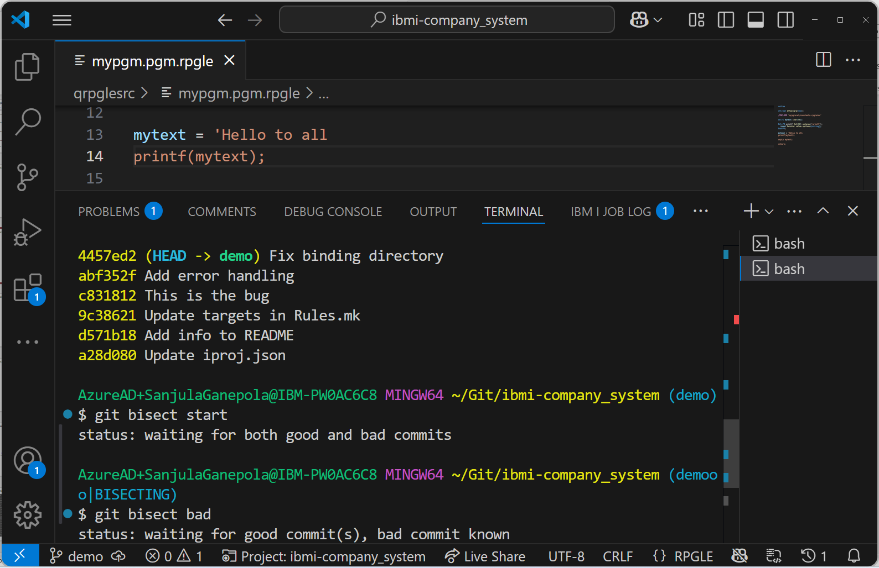
Git bisect

Slide 56

Git bisect

Slide 57

Git bisect

Slide 58

Git bisect

Slide 59

Git bisect
🚨

Slide 60

Git bisect
🚨

Slide 61
Git hooks
https://git-scm.com/book/en/v2/Customizing-Git-Git-Hooks
WORKING DIRECTORY
STAGING AREA
LOCAL REPO
REMOTE REPO
pre-commit
pre-push

Slide 62

Pre-commit to run RPG linter

Slide 63

Setup lint config

Slide 64

Git hooks

Slide 65

Git blame

Slide 66
Git in VS Code

Slide 67

Viewing changes and in-editor diff

Slide 68

Viewing Git history as a graph

Slide 69

Viewing pull requests
https://marketplace.visualstudio.com/items?itemName=GitHub.vscode-pull-request-github

Slide 70

Viewing changes in pull requests
https://marketplace.visualstudio.com/items?itemName=GitHub.vscode-pull-request-github

Slide 71
Any Questions?

Slide 72
Important Links
Installation
https://git-scm.com/downloads
https://git-lfs.com/
https://marketplace.visualstudio.com/items?itemName=GitHub.vscode-pull-request-github
Documentation
https://git-scm.com/docs
Recommended Git Tutorials
https://www.youtube.com/watch?v=-iWaarLI7zI
https://www.youtube.com/watch?v=e9lnsKot_SQ
https://www.youtube.com/watch?v=0chZFIZLR_0&t=66s

Slide 73

Sanjula Ganepola - Git Concepts I Wish I Knew Years Ago
Please take the last minute of this session to complete the evaluation. A direct link to the evaluation can be found using the QR code to the right.

